Slide 2

Your M2M Solution Partner

Slide 3
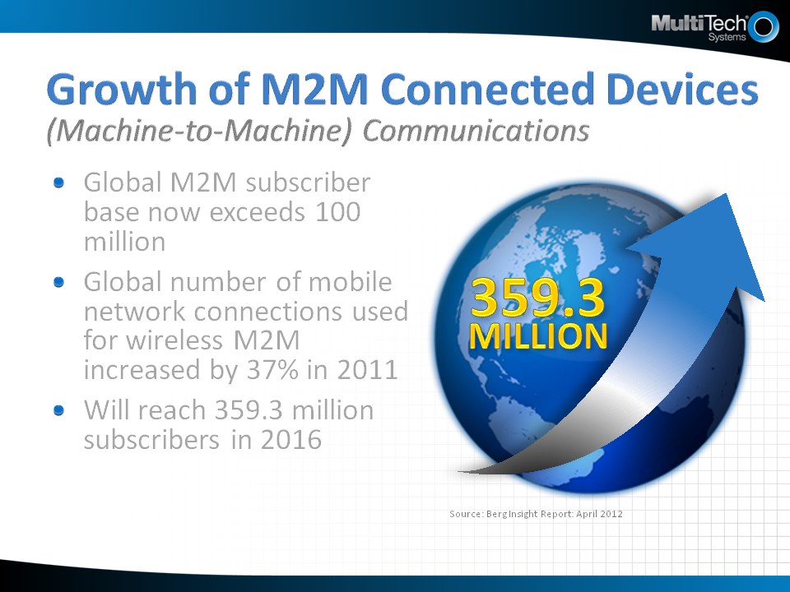

Slide 4
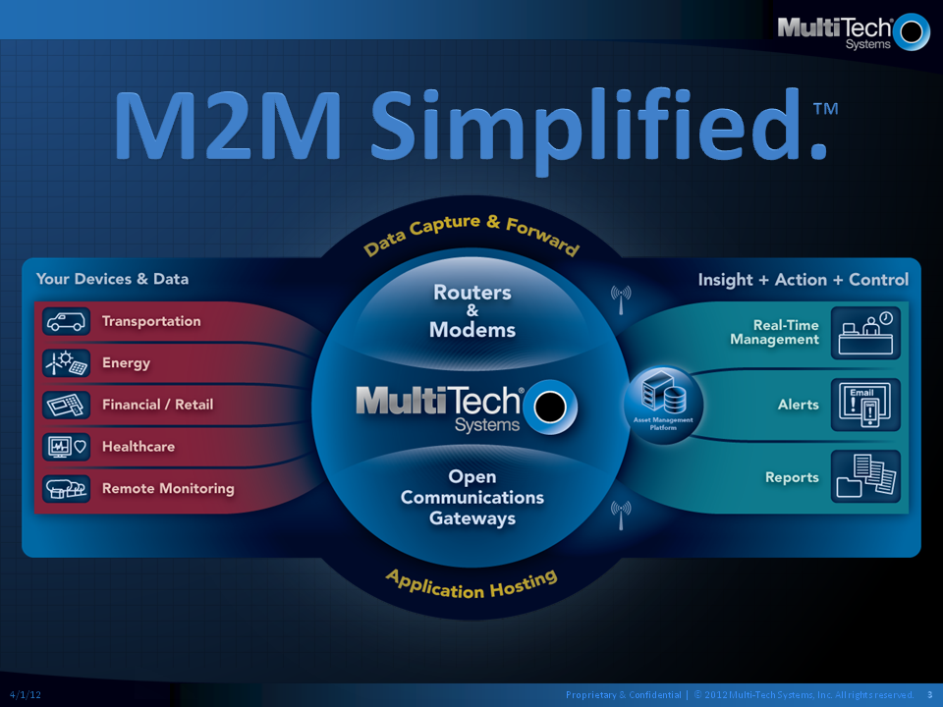

Slide 5
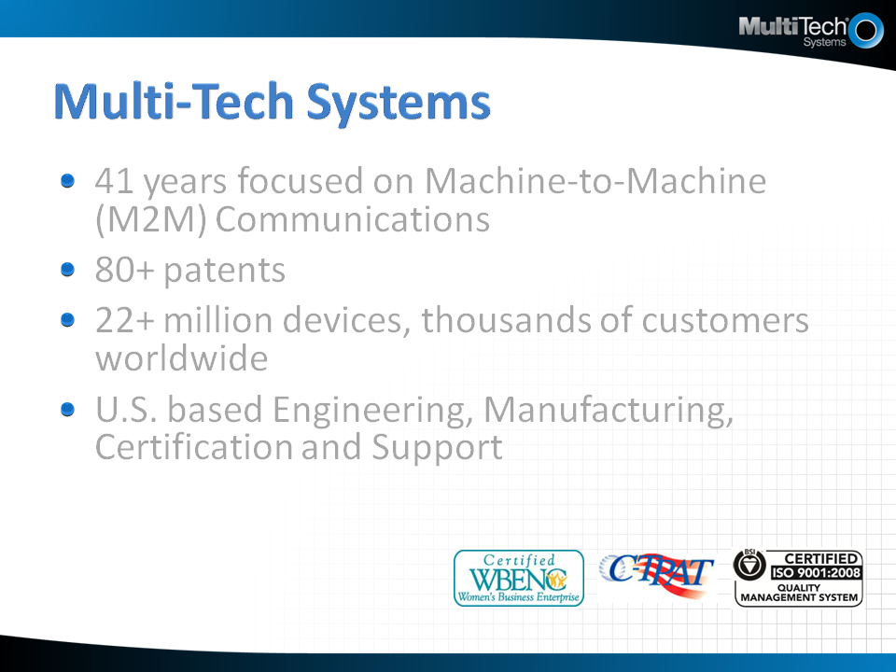

Slide 6
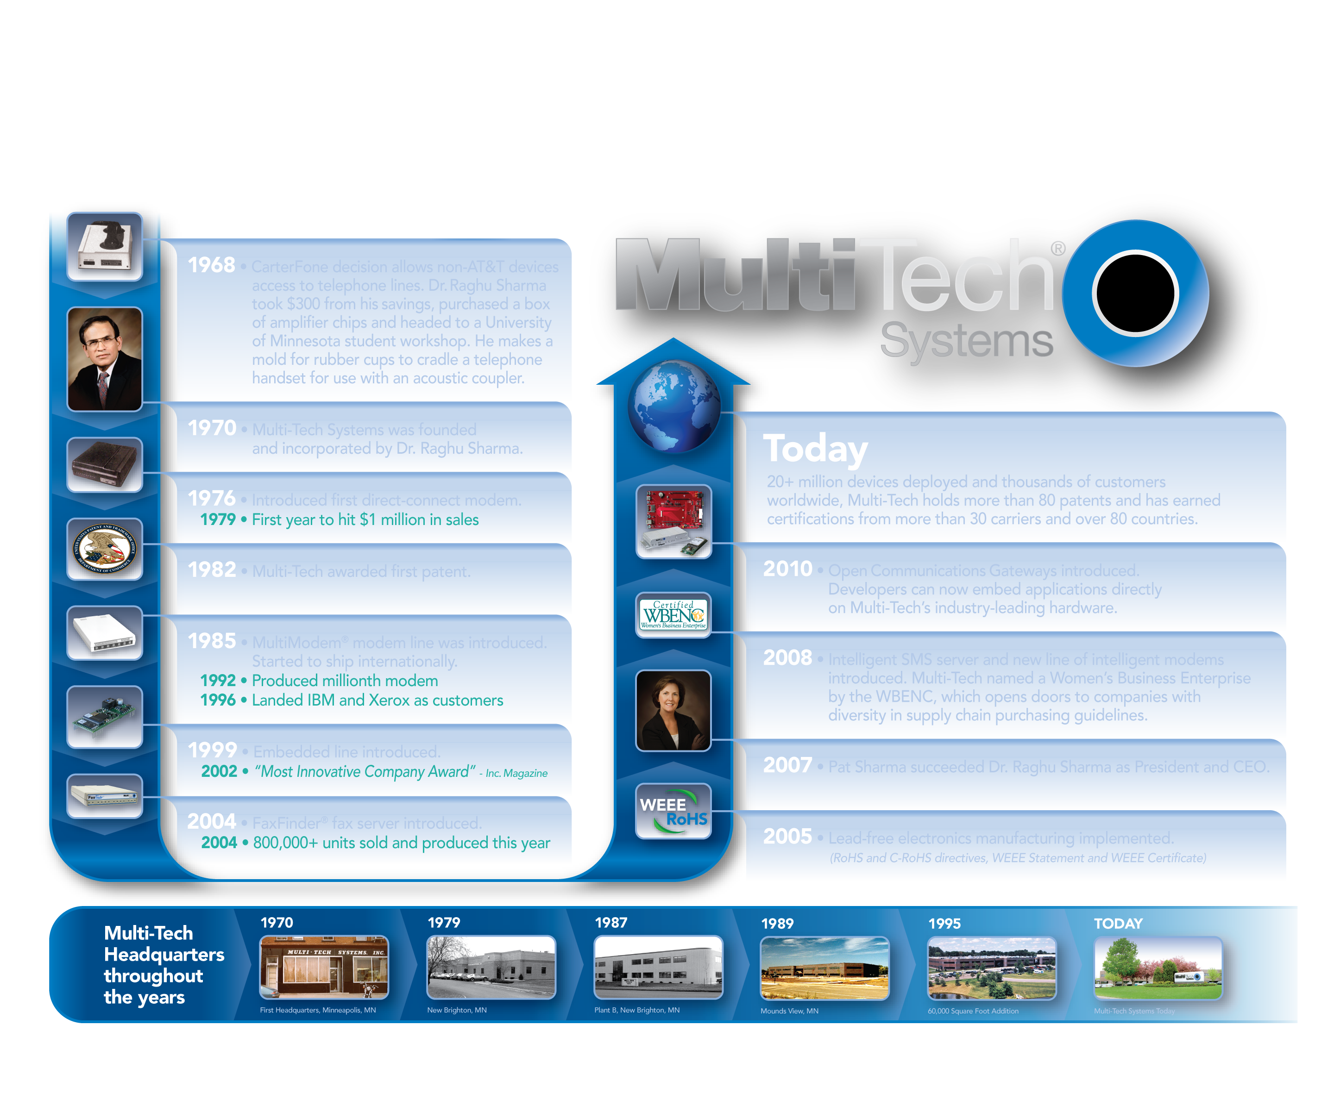
40+ Years of M2M Innovation

Slide 7
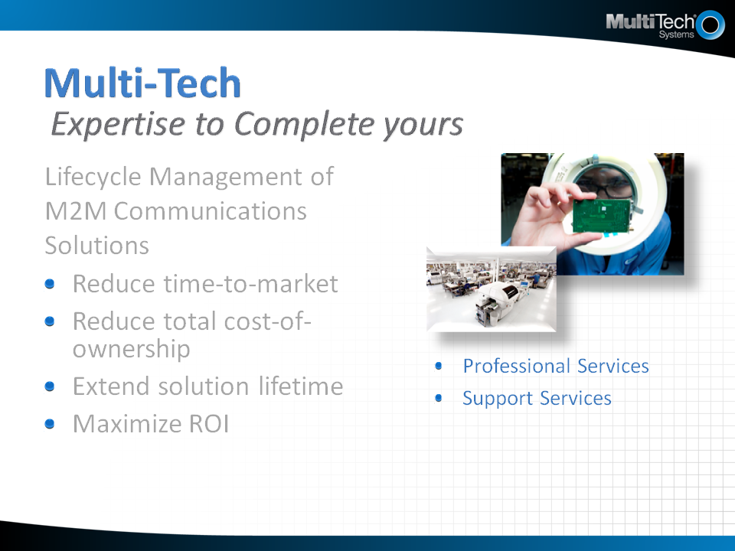

Slide 8
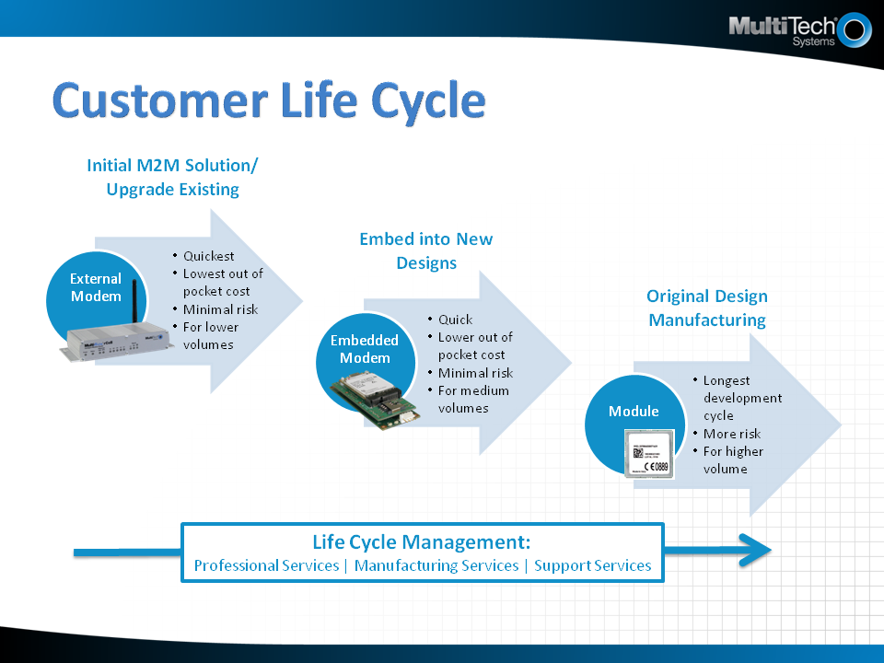

Slide 9
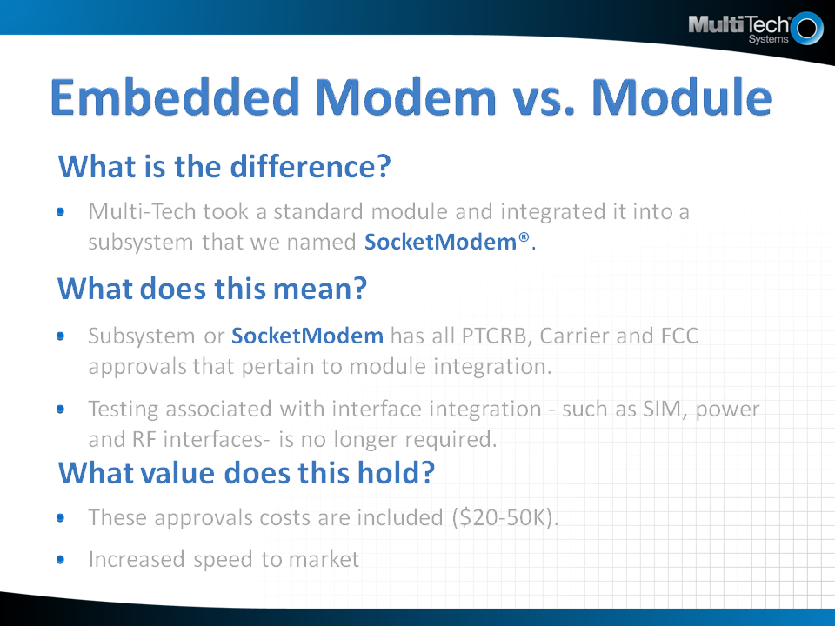

Slide 10
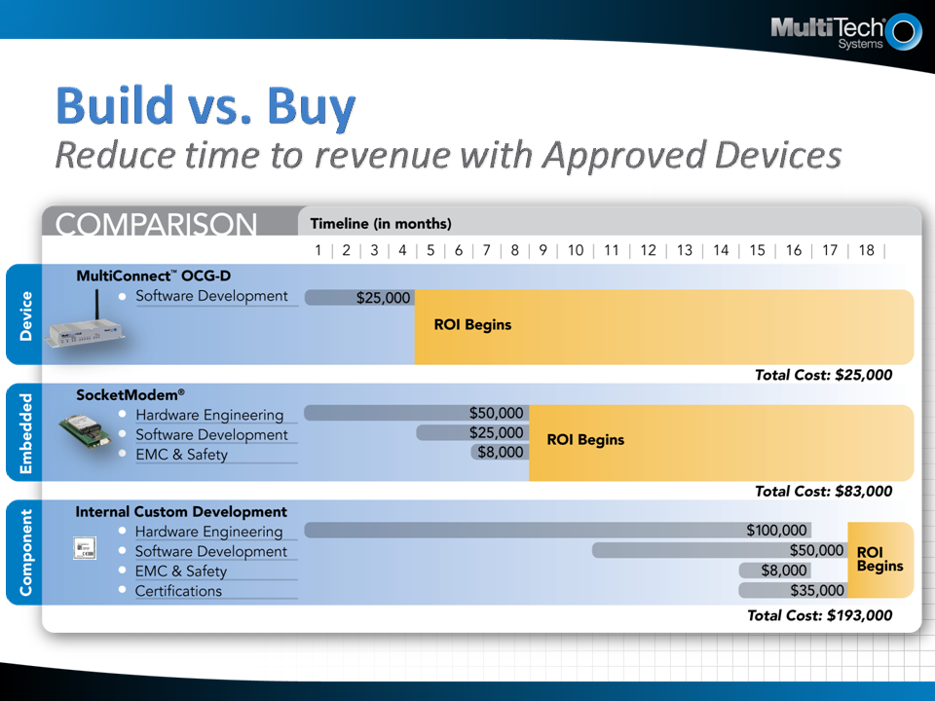

Slide 11
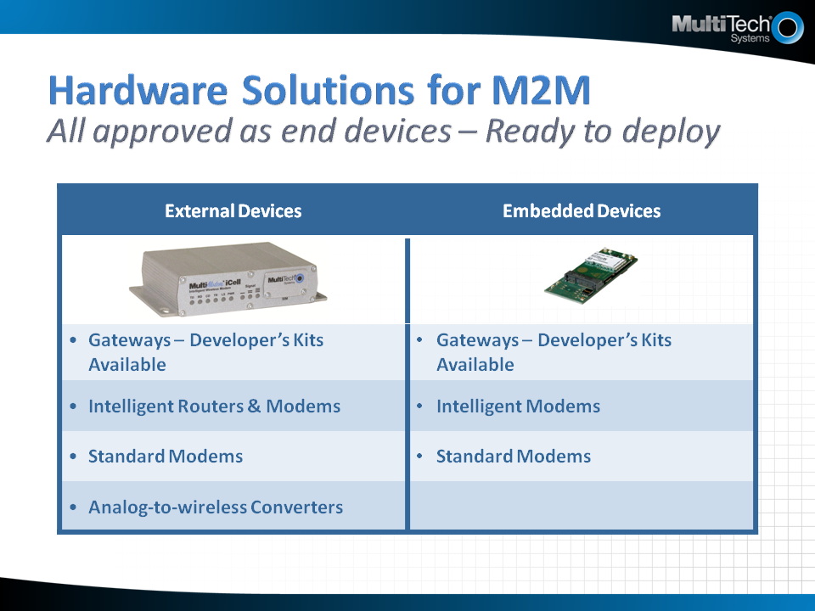

Slide 12
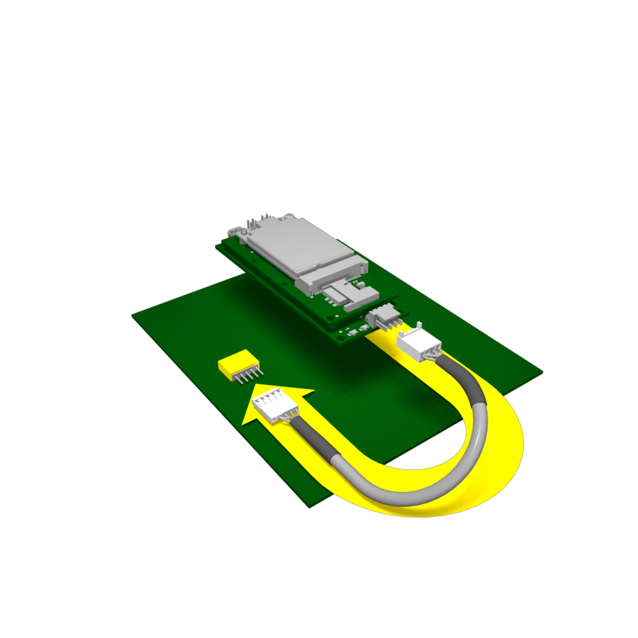
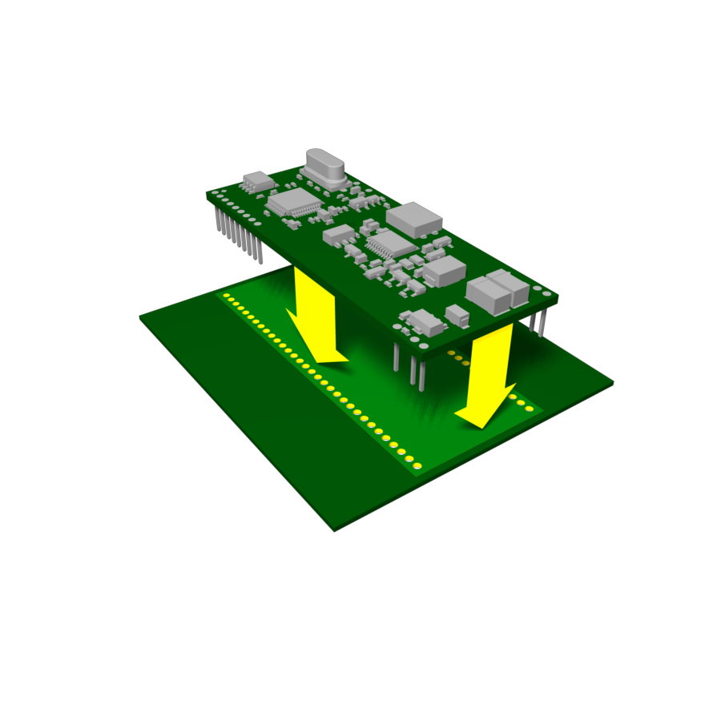
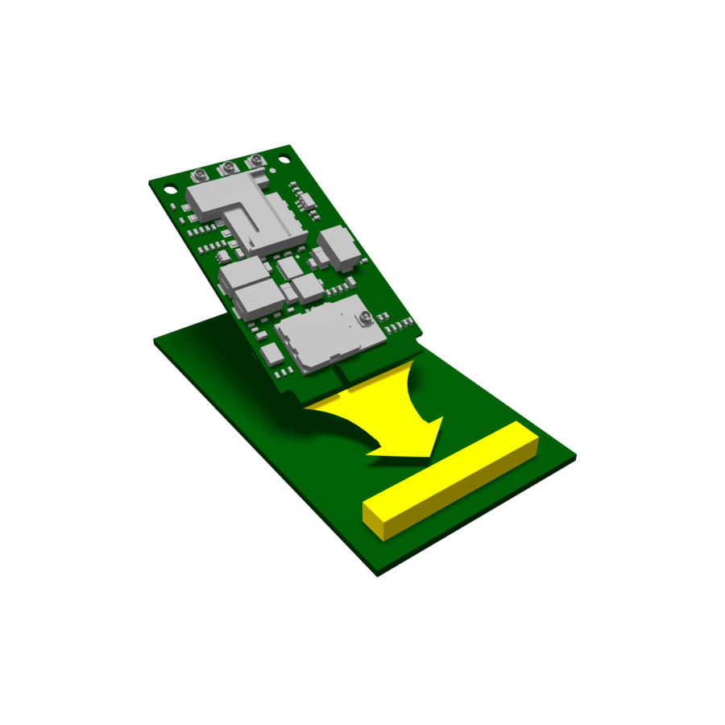
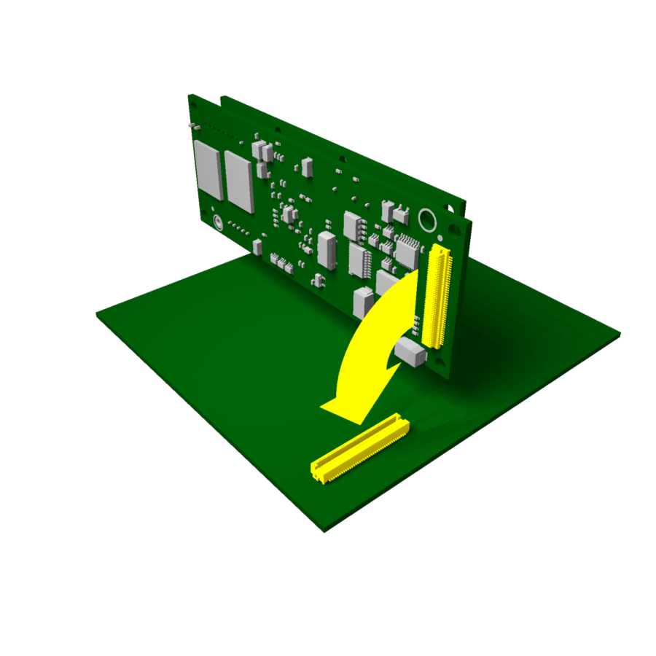
Embedded Solutions To Meet Any Need Approved by carriers as end devices
Universal Socket Footprint
PCI Express
Mini Card
4 Pin
USB
Header
80 Pin
B2B
Connector
Multiple technologies available in same form factor (GPRS, 1xRTT, HSPA, EV-DO)
Pin-out compatible for future migrations
AT command interface
Penta-band HSPA+, EV-DO Rev A
AT command compatible
Models with GPS, Wi-Fi®/ Bluetooth®, digital voice and USB 2.0 HS
Available soon
No board spin necessary
Multiple technologies available in same form factor (GPRS, 1xRTT, HSPA, EV-DO)
Easy migration to future technologies
Driver supported
Open source Linux platform
400 MHz ARM9™ CPU
256 MB NAND flash and 64 MB SDRAM
Multiple interfaces available (serial, USB host and device, Ethernet and more)
SocketModem®
MultiConnect ™ PCIe
QuickCarrier™ USB
MultiConnect ™OCG-E

Slide 13
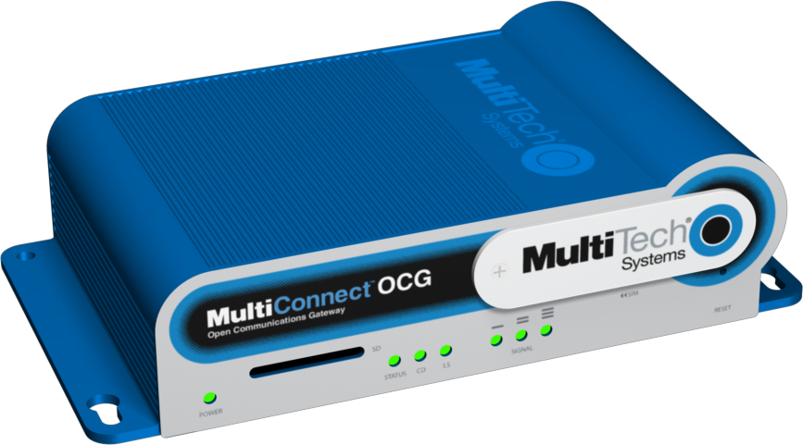
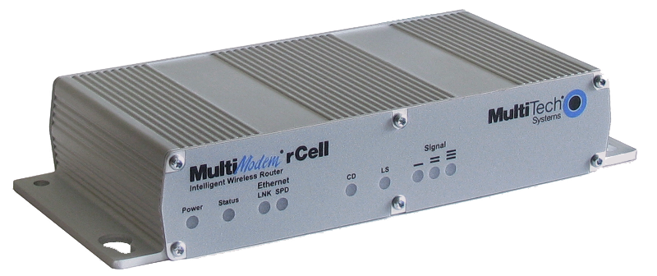
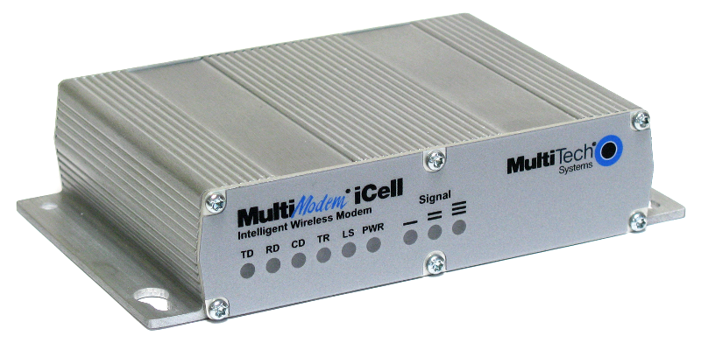
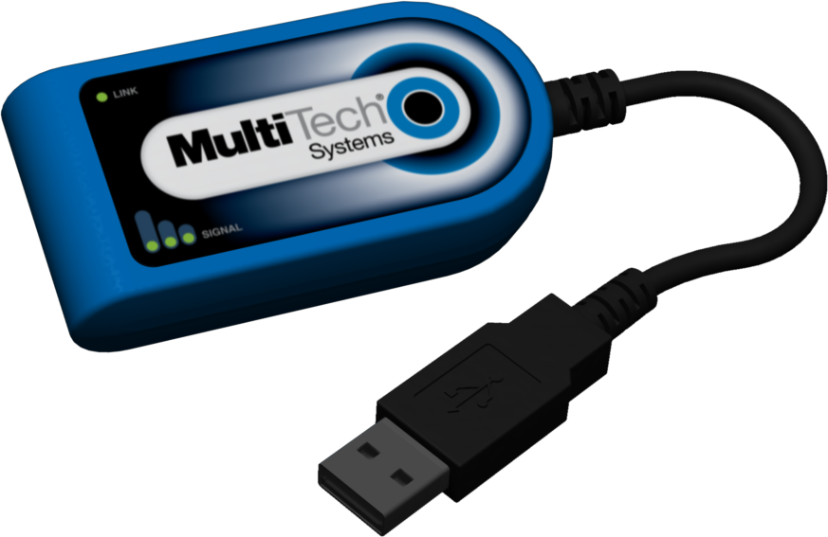
External Devices Reliable and long-lasting solutions
Gateways
Routers
Intelligent
& Standard Modems
Cellular Dongle
Penta-band HSPA+ or EV-DO Rev A
Application-ready hardware platform
Linux development environment
Serial, USB, multiple Ethernet ports and GPIO
2G and 3G, GSM and CDMA
Penta-band HSPA+ or EV-DO Rev A
Ethernet and Serial
Optional GPS
Coming soon: Wi-Fi®/Bluetooth®
2G and 3G, GSM and CDMA
Penta-band HSPA+ or EV-DO Rev A
Serial and/or USB
Intelligent models feature Universal IP stack , GPIO and optional GPS
Penta-band HSPA+ or EV-DO Rev A
Designed and built for OEM quality M2M connectivity
USB powered
Available soon
MultiConnect™ OCG-D
MultiModem® rCell
MultiModem® iCell & Cell
MultiConnect™ USB-D

Slide 14
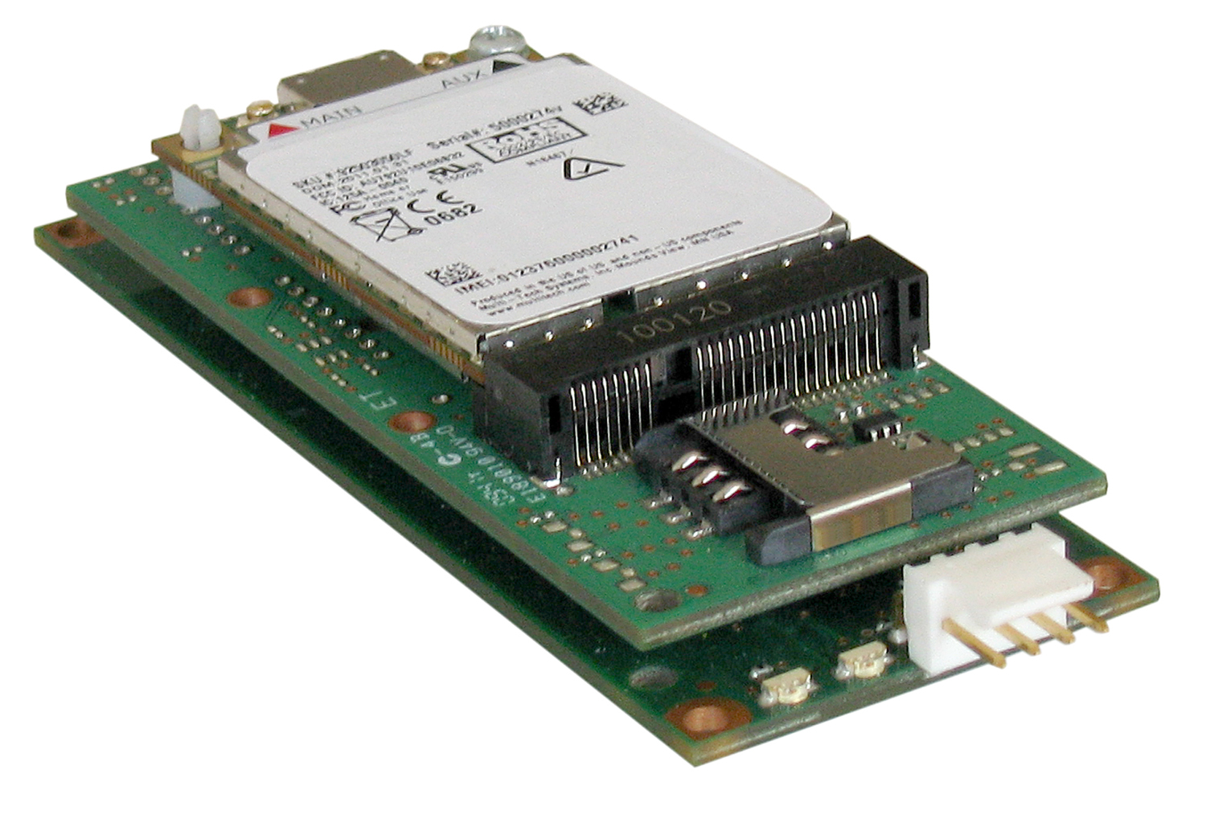
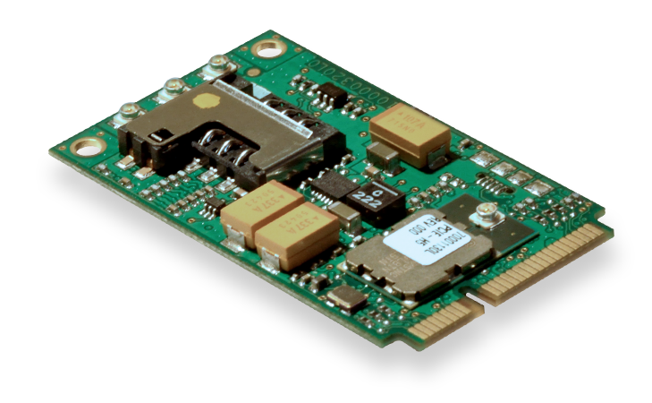
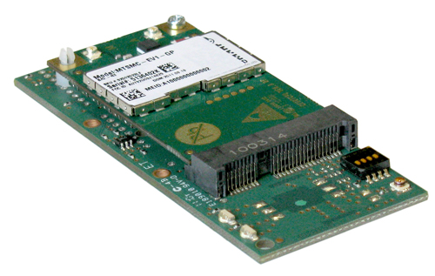
Embedded Devices Carrier Approved - GSM & CDMA
GATEWAY 80 pin Board to Board connector | MultiConnect™ OCG-E Open Communications Gateway - Embedded OpenEmbedded Linux Development Environment GPS, optional
MODEM Universal Socket | SocketModem® iCell Intelligent Embedded Cellular Serial and USB GPS GPIO
STANDARD MODEM Universal Socket | SocketModem® Cell Embedded Cellular Serial or USB Embedded TCP/IP stack
USB MODEM Universal Socket | QuickCarrier™ USB Embedded USB Cellular Cellular modem and USB carrier card in one Cellular connectivity without a redesign
MINI PCIe Mini UPCI | Future: Mini PCIe Serial and USB Bluetooth® and Wi-Fi® GPS, optional

Slide 15
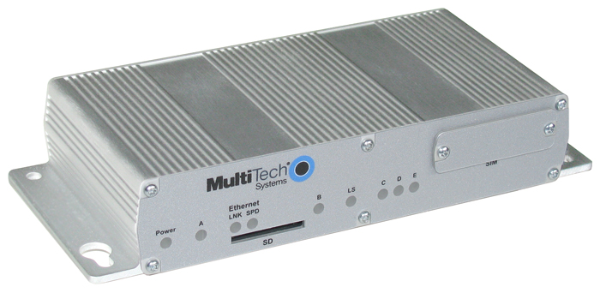
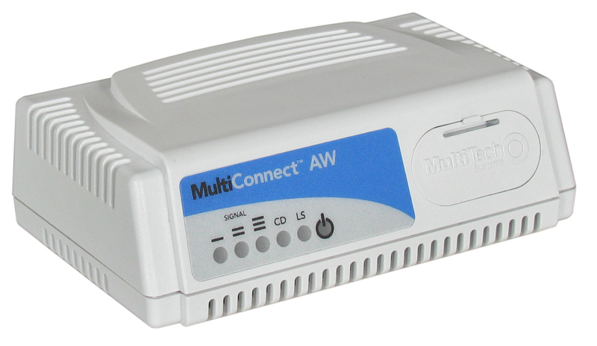
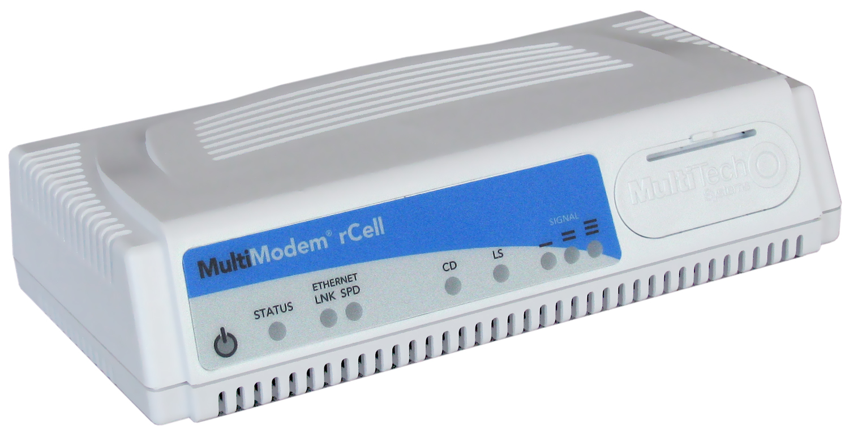
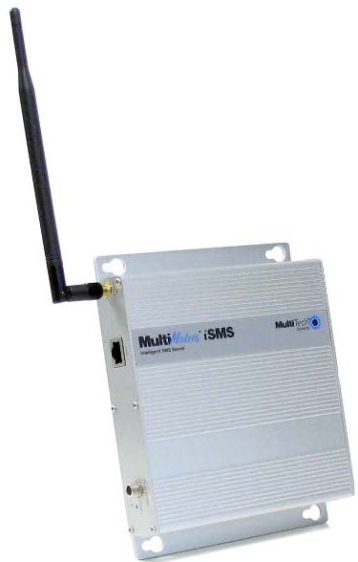
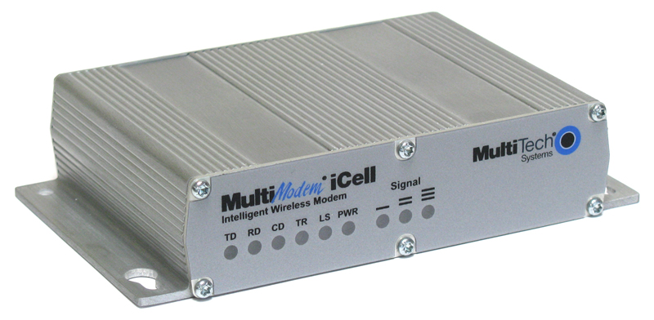
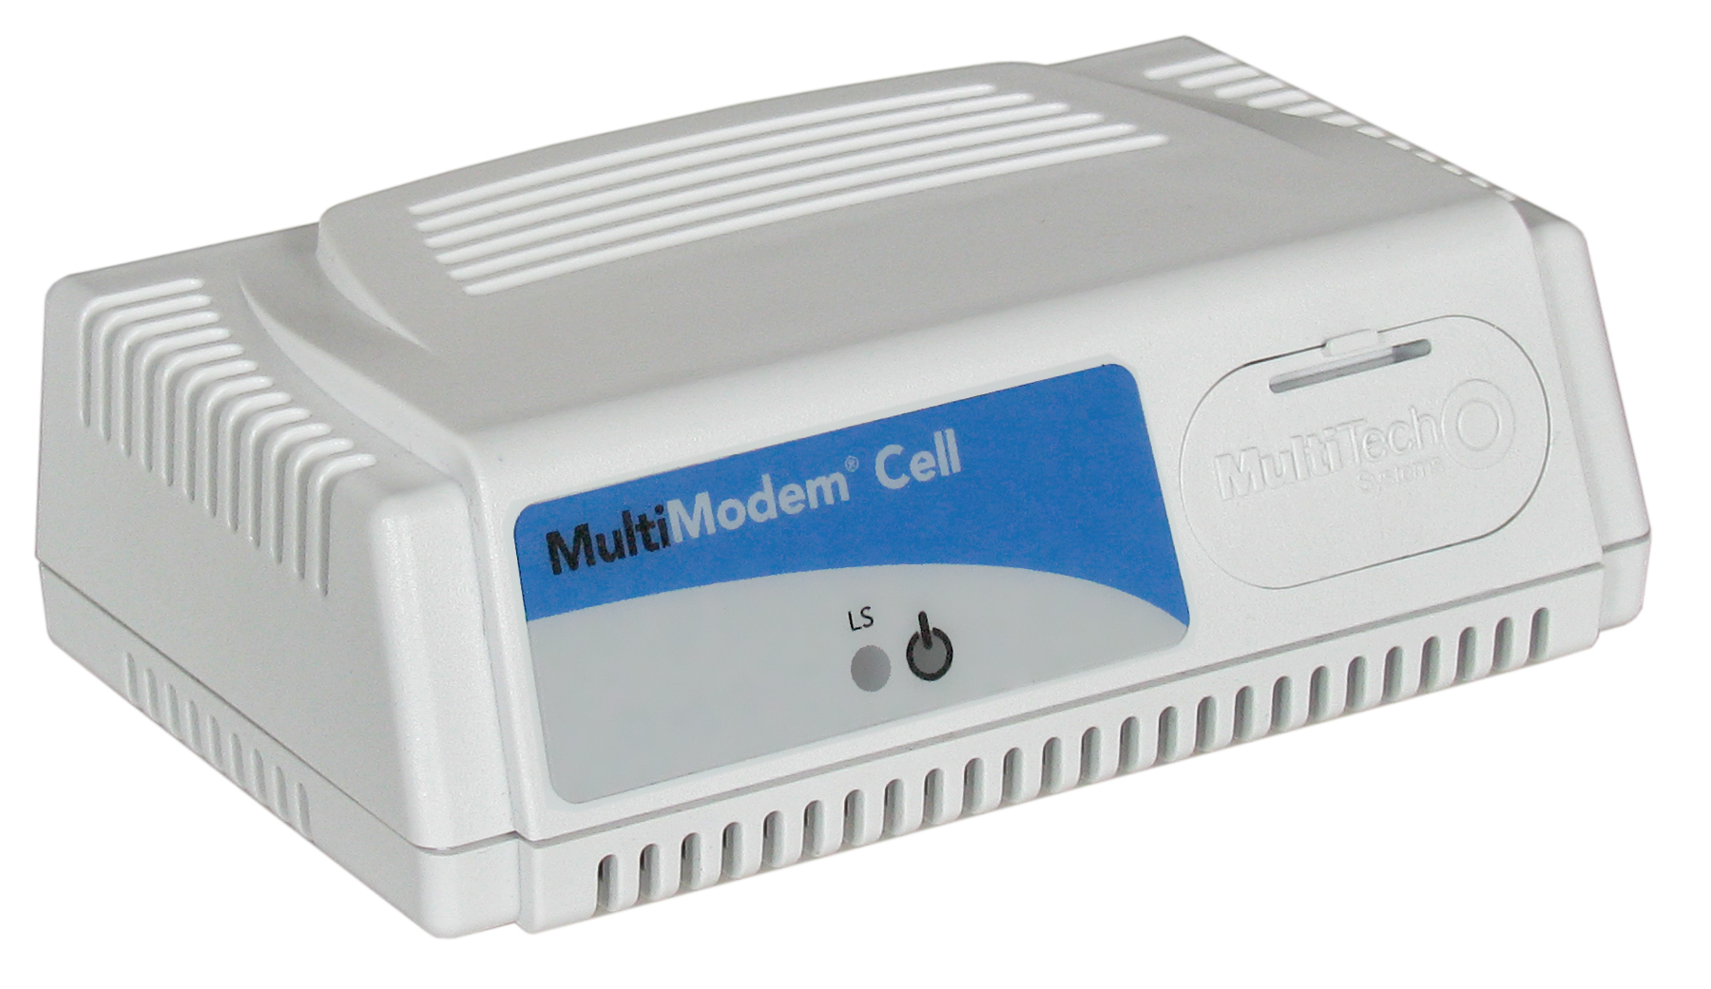
External Devices Carrier Approved - GSM & CDMA
GATEWAY | MultiConnect™ OCG-D Open Communications Gateway Ethernet and Serial GPS, optional
ROUTER | MultiModem® rCell Intelligent Wireless Router Ethernet and Serial GPS
INTELLIGENT | MultiModem® iCell Intelligent Cellular Modem Serial and USB GPS GPIO
STANDARD | MultiModem® Cell Cellular Modem Serial or USB
CONVERTER | MultiConnect™ AW Analog-to-Wireless Converter Cellular connectivity for legacy devices with analog modems Outbound and inbound calling
SMS SERVER | MultiModem® iSMS Intelligent SMS Server Sends application information by SMS text messages API for ease of integration Web-based management and configuration

Slide 16
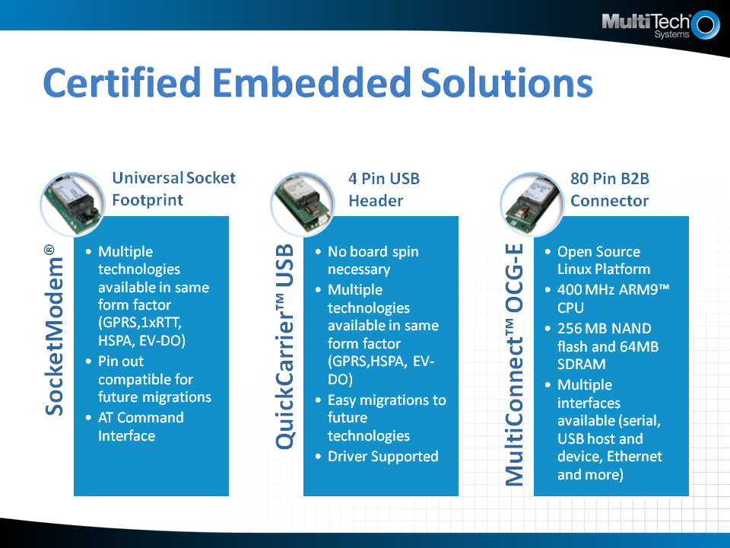

Slide 17
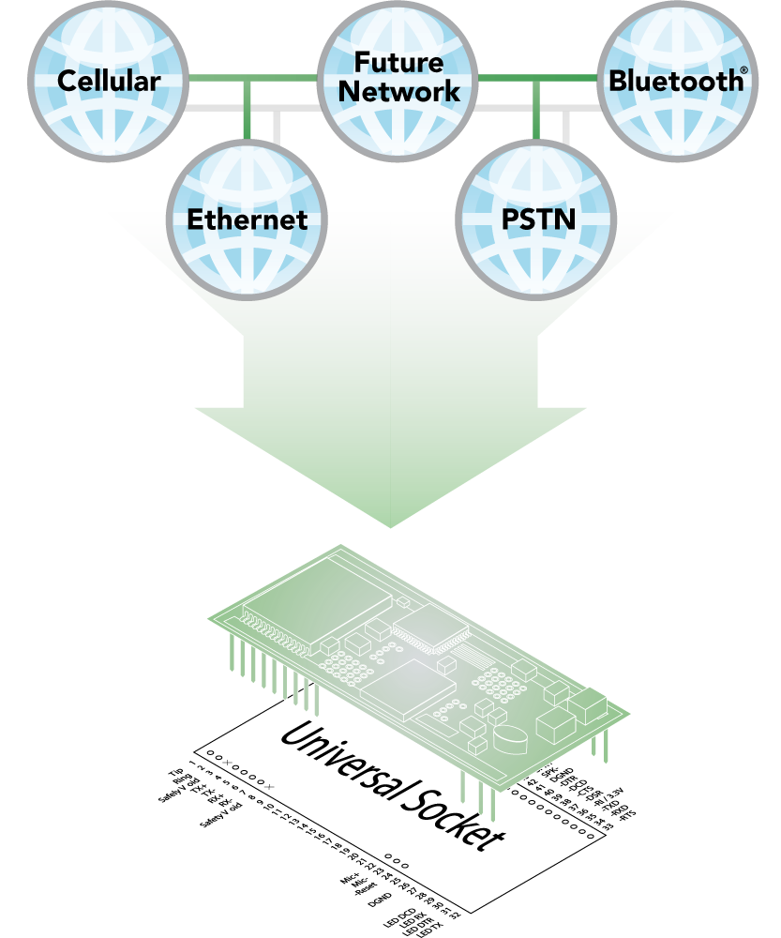
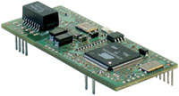

Embedded Device Servers Universal Socket Footprint with Universal IP
ETHERNET | SocketEthernet IP® Intelligent Serial-to-Ethernet
BLUETOOTH | SocketWireless® Bluetooth® Intelligent Serial-to-Bluetooth

Slide 18
Universal IP® Consistent Design Interface
For applications where enhanced M2M communications is required
Future-proofs applications as new technologies are introduced
Allows developers to write host application with freedom to select from growing number of Universal Socket devices

Slide 19
Universal Socket Flexible comm-port architecture
Utilize one system design and populate it with your connectivity module of choice
Easy migration to future networks
Quick to market

Slide 20
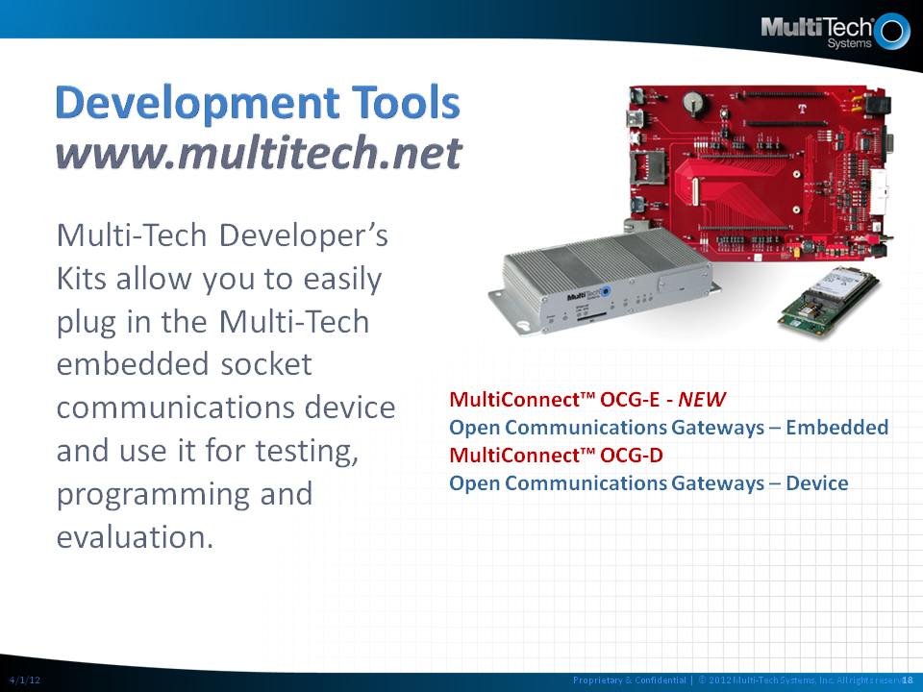

Slide 21
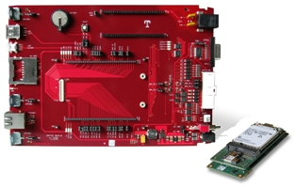

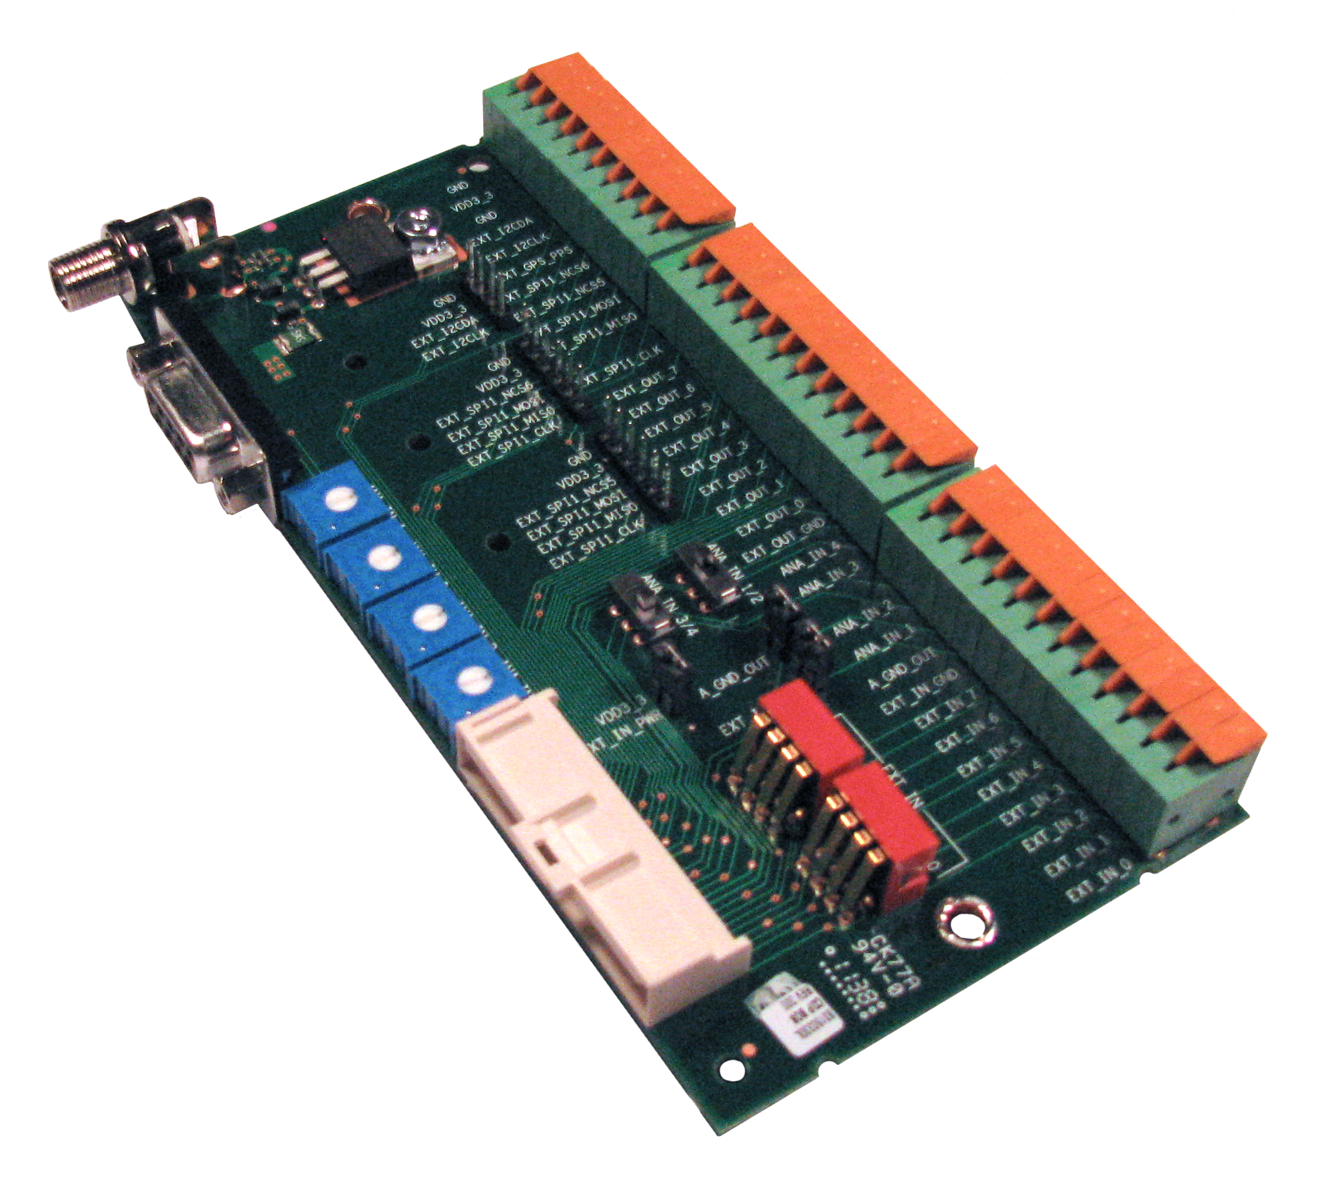
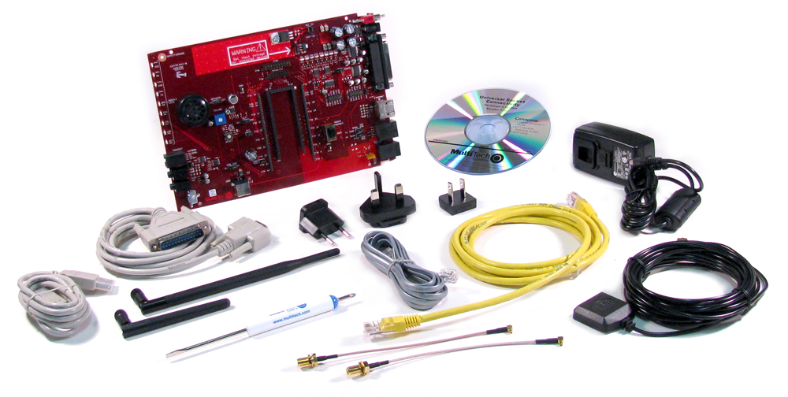
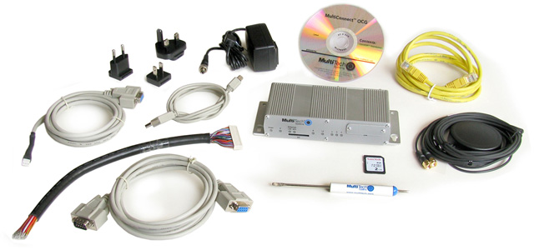
Development Tools
 | MultiConnect™ OCG-E Open Communications Gateway - Embedded MT100EOCG-DK Quick and easy to prove concept Available with free 90 day data plan
 | MultiConnect™ OCG-D Open Communications Gateway - Device MTCDP-DK Develop and deploy Available with free 90 day data plan
 | Break-out Board with GPIO Cable MTOCG-BOB-DK Quick and easy way to develop and provde concept using MultiConnect OCG
 | Universal Socket MTSMI-UDK Plug in the communications device and use it for testing, programming and evaluation

Slide 22
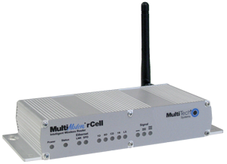

Broad Product Portfolio
Device or Embedded | PSTN | Device Servers | 2G GSM/GPRS & CDMA | 3G HSPA & EV-DO | 4G LTE [FUTURE]
 | MultiModem® ZDX |  | MultiConnect™ OCG-D | MultiConnect™ OCG-D | MultiConnect™ OCG-D
 | MultiModem® ZBA |  | MultiModem® rCell | MultiModem® rCell | MultiModem® rCell
 | MultiModem® IND |  | MultiModem® iCell | MultiModem® iCell
 | MultiModem® ZPX* |  | MultiModem® Cell | MultiModem® Cell
 | MultiMobile® USB
 | MultiModem® ISI*
 | SocketModem® IP | SocketEthernet IP® | SocketModem® iCell | SocketModem® iCell | SocketModem® iCell
 | RJModem™ | SocketWireless® Bluetooth® | SocketModem® Cell | SocketModem® Cell | SocketModem® Cell
 |  |  | QuickCarrier™ USB | QuickCarrier™ USB
*Internal PC Modems
Interface Key
Ethernet, Serial & USB | Ethernet & Serial | Serial -&- USB | Serial -OR- USB | Serial | USB
Notes:
Multi-Tech Systems has a feature set to suit any need in any market

Slide 23
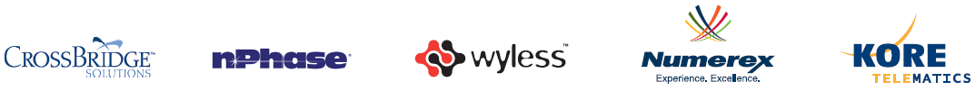
M2M: Subscription Services Key Relationships to Succeed in M2M Arena
MVNO | GSM (US) | CDMA | Website
CrossBridge Solutions | AT&T | Sprint | Crossbridgesolutions.com
KORE Telematics* | AT&T | Verizon | Koretelematics.com
nPhase | AT&T | Verizon/Vodafone | nphaseM2M.com
Numerex* | All Global GSM Carriers | Sprint, US Cellular | Numerex.com
Wyless* | T-Mobile | Sprint | Wyless.com
*Considered an MVNE

Slide 24
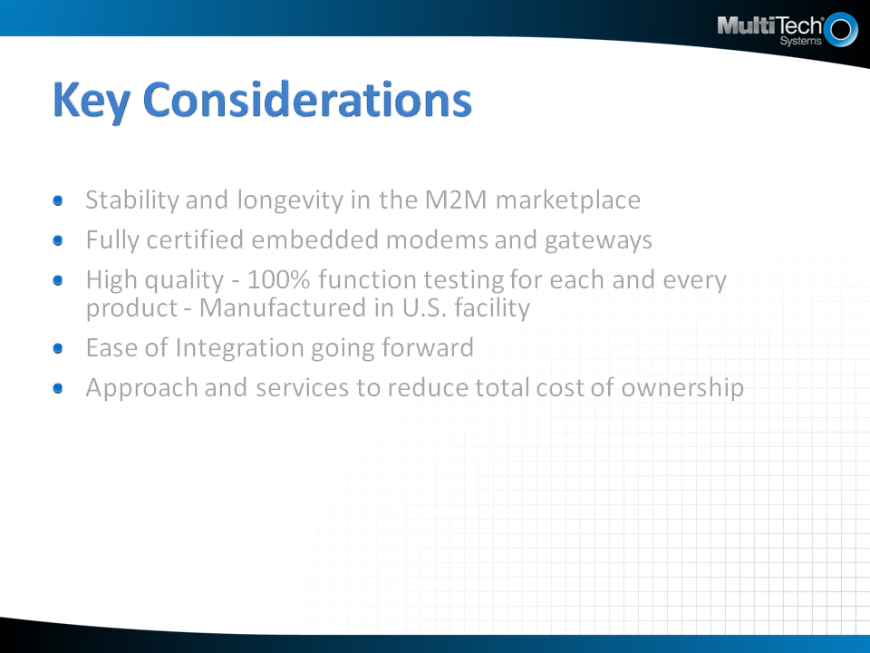

Slide 25
Awards & Accolades
2011 Unified Communications Excellence Award (TMC)
2010 M2M Evolution Product of the Year award (TMC)
Connected World (M2M Magazine) Top 100 (2003 – 2010)
M2M Value Chain Award – 2009, 2010, 2011 & 2012
2011 Internet Telephony Excellence award (TMC)

Slide 26
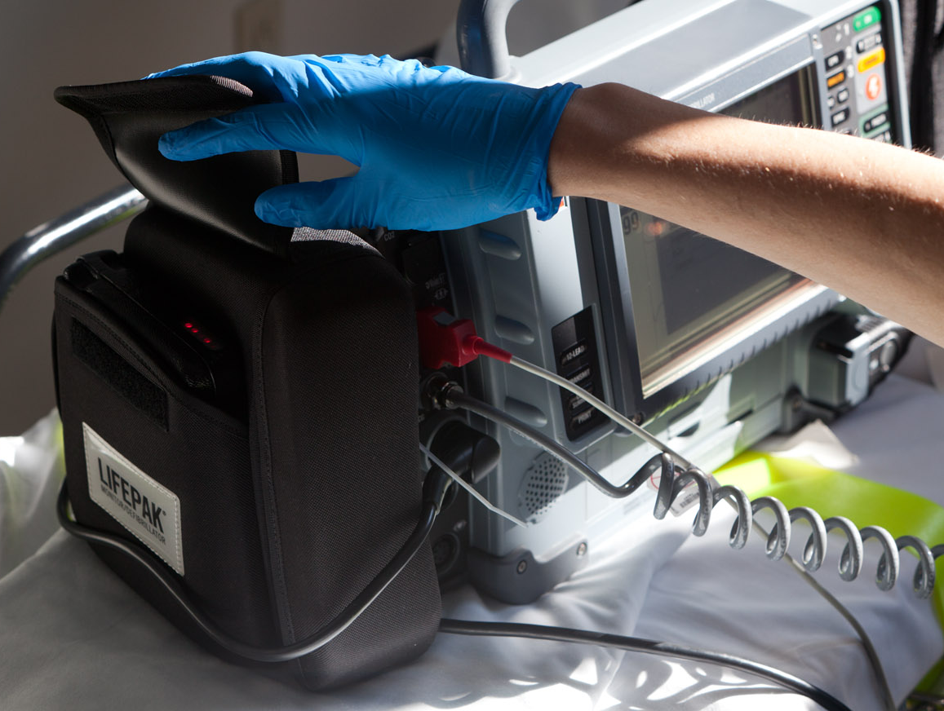


Customer Case: Physio-Control
challenges
Cellular infrastructure changes from city to city and around the globe
New cellular technologies being introduced
Physio-Control needed to upgrade software to accommodate faster, more reliable data transfer, yet preserve usability of deployed units
Portable monitor/defibrillator sends remote patient data to hospital to improve time to treatment.
solution
MultiConnect™ OCG Open Communications Gateway
3G enables more patient data to be transmitted faster to improve patient care
Allowed Physio the ability to control software engineering and legacy quality system
Future-proofs designs

Slide 27


Customer Case: Coulomb
challenges
Flexibility to set up a charging station on virtually any street corner where traditional phone lines may not be available
Get to market quickly and cost-effectively
Electric Vehicle Charging Stations enabled with M2M communications connects charging stations and HQs quickly and affordably
solution
MultiModem® Cellular Modems
Easy integration: Simply plug in and set it up to call network
Affordable 2G solution
Investment protection with advanced forward compatible design

Slide 28


Customer Case: Lat-Lon
challenges
Lat-Lon needed to connect to various wireless technologies
Get to market quickly
Solar Tracking Unit, enabled with real-time cellular communications, protects cargo and saves costs, plus enhances asset performance, increases safety and saves fuel.
solution
SocketModem® Embedded Cellular Modems
Ready to integrate and carrier approved as end-device means Lat-Lot didn’t need to pursue its own certifications
Universal Socket and Universal IP® allowed the addition of cellular communications with minimal engineering effort

Slide 29





























Multi-Tech Systems Customers

Slide 30




Multi-Tech Industry Certifications and Designations
International Organization for Standardization Certificate for Quality Management | International Organization for Standardization Certificate for Medical Devices Quality Management | A resource for companies and government agencies that rely on WBENC's certification as part of their supplier diversity programs | Restriction of Hazardous Substances compliant | Waste Electrical and Electronic Equipment compliant

