Slide 1

Connected Technology
How can M2M Impact your Business today?

Slide 2






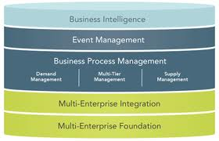


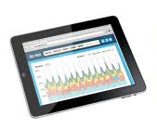

M2M (Machine to Machine) Communications Gather and process data collected by machines
Transportation
Healthcare Monitors
Energy Meters
Financial / Retail
Remote Monitoring
Non-Exhaustive
REMOTE ASSETS
COMMUNICATIONS
M2M APPLICATION
Embedded with a cellular modem, cellular module, sensor and/or GPS unit)
Mobile network transfers data gathered from Smart Sensors to a central M2M platform
Platform based software that controls the smart sensors, processes gathered data to generate intelligence
Notes:
Wireless enabled smart sensors are continuously sending digital information, at programed intervals, to a centralized data store for processing.
Companies gathering this data are processing it either on-premise, or in cloud (progressive companies) to generate either top-line or bottom-line influencing insights.
Utilizing our Mobility Services Offering, Accenture has enabled several companies around the globe utilize M2M services to improve their business
Accenture and Verizon have partnered together to deliver a host of mobile heath solutions in the marketplace today
Our experience shows that various other industries that have progressively begun to take advantage of the market opportunities that M2M enables. Specific examples of M2M enablers for five different verticals and their impact on businesses will be examined today

Slide 3

M2M Connectivity The “Connected Machines” Universe Represents Incredible Opportunity
Explosive Growth Enabling Business Outcomes
A $32B market*
Healthcare
Finance
Utilities
Security
Retail
Automotive
Fleet
Industrial/Other
360 million in 2016
*Combination of Device and Connectivity Revenues
Sources: ABI Research, Berg Insight, Accenture Analysis
110 million in 2011
Notes:
What is M2M? Lets talk about M2M – Machine to machine connectivity
M2M market was strong in 2011, displaying growth in all major world regions and vertical segments.
Global M2M subscriber base now exceeds 100 million
The most significant market development in 2011 was a major breakthrough for cellular M2M
communication in Asia-Pacific. The number of M2M subscribers in the region increased by 64
Percent.
North America and Europe recorded annual growth rates of around 26 percent each.

Slide 4
Where is M2M used?
Transportation
Asset Tracking
Healthcare
Home & Mobile
Finance - Retail
Fleet Management
Parking Meters/ Terminals
Driver behavior
Asset Monitoring
ATM
Remote Monitoring
Energy
Energy Monitoring
Smart Grid
Renewables / Wind
Car Charging Stations
Utility Controls
Environmental Monitoring
Tele-Monitoring
Disease Management
Assisted Living
POS
Temporary Kiosks
Vending Machines
Cash Registers
Security & Surveillance
Remote Service Alarming
Smart Robotics
Smart Metering
Notes:
Multi-Tech’s key vertical markets.
Among business applications, Transportation continues to be the largest vertical, and still growing at double digit rates - IMS Research forecasts modules used in automotive market will have a 31% CAGR during the forecast period. Growth is being supported by government regulations.
While the overall outlook is bright, concerns over the cost, reliability, and security of cellular technology will limit uptake of cellular modules in some vertical markets for the near term. Markets including security and factory automation are likely to rely on wired connectivity as well as alternative wireless options for a good portion of their M2M communications. At the same time, healthcare, a market with great potential for cellular modules, must overcome a series of privacy and liability concerns before it can reach a larger market size.
Diverse industries, ranging from metering to digital signage, are becoming more reliant on cellular technology as a means to transmit vital information.
Site 1-2 vertical market examples
(SITE AN EXAMPLE)
Let’s say you own a fleet of construction machines (a forklift, some generators, a boom truck, etc.).
Consider connecting all your equipment so they can “socialize.” Equip them with cellular and GPS connectivity, all reporting back to a simple application you manage from your iPhone, iPad or other handheld device – no matter where you are on the globe in relation to your machinery. Now you have access to real time data about your network. Where are my machines (GPS)? How many are currently in use? How many hours until maintenance is due? Why is that machine unnecessarily running? Click here to power it off. Done. Simple. That’s M2M!
Wheather you are solving a problem, offering a feature, reducing expenses, or creating a reoccurring revenue model…
M2M BRINGS ROI!

Slide 5
Five Business Impacts
Operational Efficiencies
1
Service to Your Customers
Reducing Costs
Shifting Business Models
Opening New Revenue Streams
2
5
3
4

Slide 6
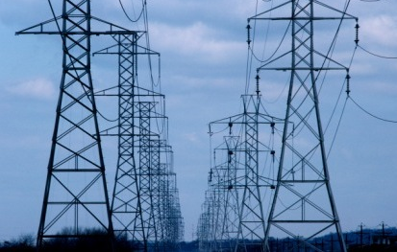
1. Operational Efficiencies
ENERGY
“Smart Controls” on electric distribution grids have driven the need to communicate with the equipment.
Process Automation
Inventory Management
Asset Management
Real Time Usage
Device Behavior
Employee Behavior
Product Warranty
Remote Device Support

Slide 7
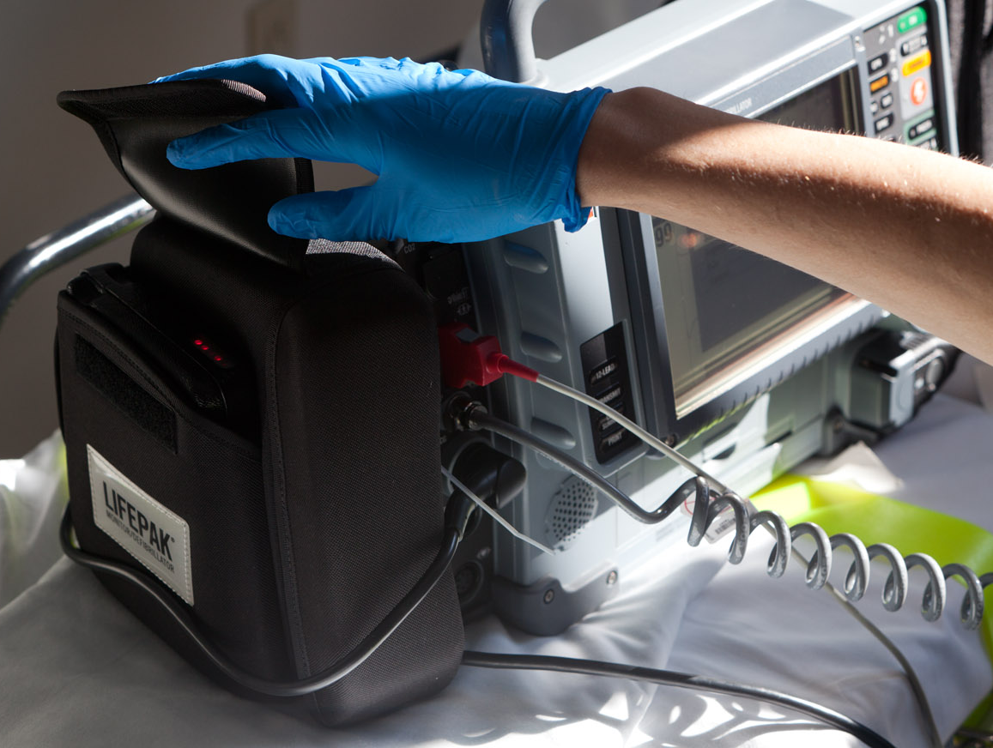
2. Service to your Customers
HEALTHCARE
Portable monitor/defibrillator sends remote patient data to hospital to improve time to treatment.
Real Time Data
Critical Patient Data
Better Support
Remote Diagnostics
In Home Monitoring
Device Management Capabilities
Notes:
challenges
Cellular infrastructure changes from city to city and around the globe
New cellular technologies being introduced
Physio-Control needed to upgrade software to accommodate faster, more reliable data transfer, yet preserve usability of deployed units
solution
MultiConnect™ OCG Open Communications Gateway
3G enables more patient data to be transmitted faster to improve patient care
Allowed Physio the ability to control software engineering and legacy quality system
Future-proofs designs

Slide 8
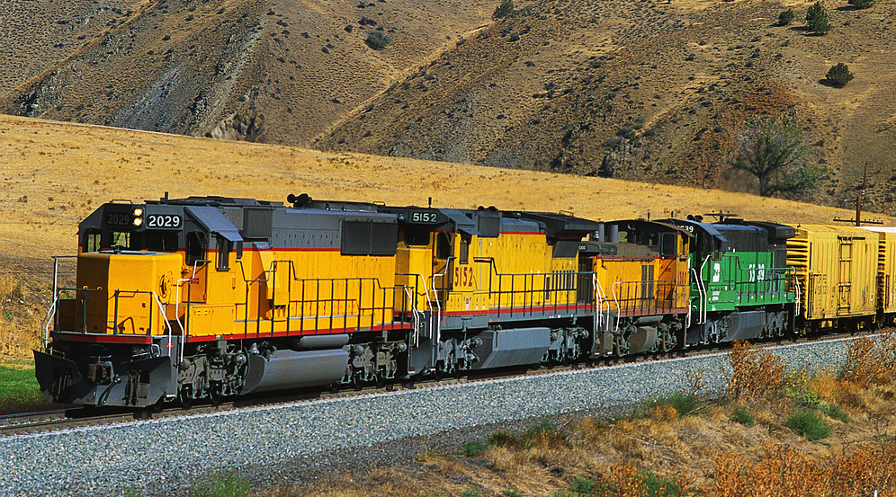
3. Reducing Cost
TRANSPORTATION
Solar tracking unit, enabled with real-time cellular communications, protects cargo and saves costs, plus enhances asset performance, increases safety and saves fuel.
Smart truck rolls
Event only based monitoring
Lowering maintenance costs
Energy management
Over the air software upgrades

Slide 9
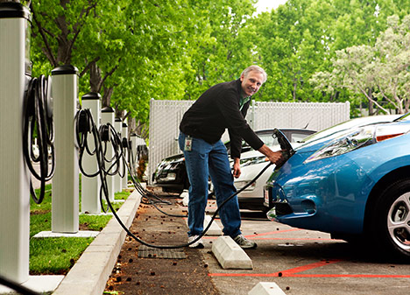
4. Shifting Business models
ENERGY/TRANSPORTATION
Electric vehicle charging stations enabled with M2M communications connect charging stations and HQs quickly and affordably.
Pay for service models
Usage based models
Warranty offerings
Leasing models
Proactive services
Notes:
challenges
Flexibility to set up a charging station on virtually any street corner where traditional phone lines may not be available
Get to market quickly and cost-effectively
solution
MultiModem® Cellular Modems
Easy integration: Simply plug in and set it up to call network
Affordable 2G solution
Investment protection with advanced forward compatible design

Slide 10

5. Opening New Revenue Streams
LAW ENFORCEMENT
Vehicles use a breath test module, a vehicle control module, and a positive ID module that are enabled with real time cellular connectivity.
Reoccurring revenue streams
New markets
Increased usage based on increased availability
Government contracts
Service based sales
Annuity selling

Slide 11

Thank you!
Questions?
Contact Multi-Tech Systems
Sales: 888-288-5470
www.multitech.com | www.multitech.net

