Slide 1
Semtech Wireless Products

Slide 2
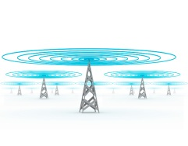
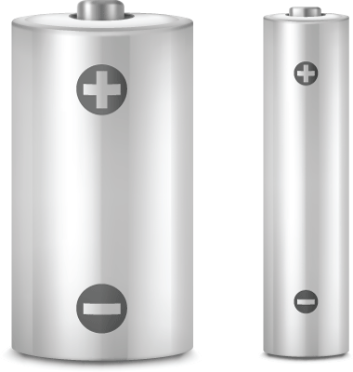
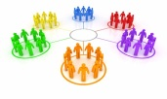





Standardization and a strong ecosystem are key to enable IoT
LoRa™ Network Features:
LoRa™ Alliance Status:
More than 90 members in LoRa Alliance, including industry leaders
Cisco, IBM, Microchip, SK Telecom, Bouygues Telecom, Swisscom, Semtech, etc
Members engaged with more than 50 MNO and major utilities
Deployments: US, France, South Africa, Switzerland, Netherlands, Russia, Belgium, and China
Module BOM cost $2-5
More than 100 LoRaWAN products available
Roadmap – low cost localization
Long Range
Max Lifetime
Multi-Usage
Low Cost
LoRaWAN™ Differentiation & Benefits
True Location
Bidirectional
Global Mobility
Security

Slide 3
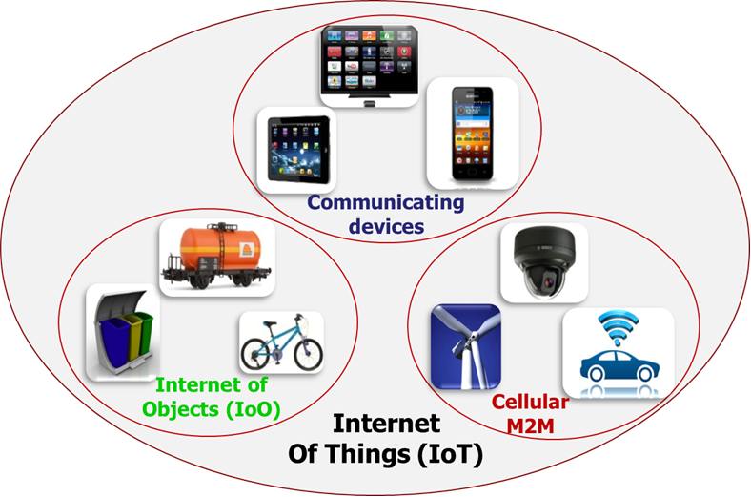
IoT Segments
IoT Projected Volumes
* 50B Connected Devices in 2020
*
Connected Devices by 2020 (billions)

Slide 4



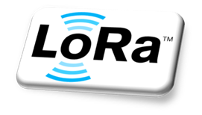




IoT Segment Trade-offs
LAN
LPWAN
Cellular
Short Range
Communicating Devices
Long Range w/ Battery
Internet of Objects
Long Range w/Power
Traditional M2M
35% SOM
55% SOM
10% SOM
Well established standards
Good for:
Mobile devices
In-home
Short range
Not good:
Battery life
Long range
Emerging PHY solutions
Good for:
Long range
Long battery
Low cost
Positioning
Not good:
High data-rate
Well established standards
Good for:
Long range
High data-rate
Coverage
Not good:
Battery life
Cost

Slide 5
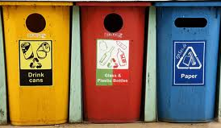


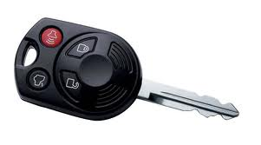
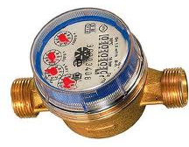
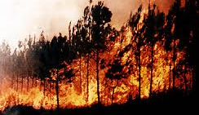
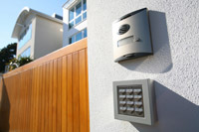
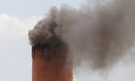
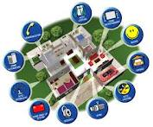


IoT: Private vs Public Network
Private network – individually managed networks
Individual network – Metering, security, home automation, industrial control
Public network – Telecom/operator managed networks
Includes traditional private networks and permits numerous new applications
A much more scalable model
Public
Network
Private
Network

Slide 6
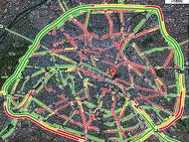

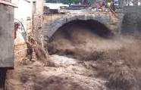

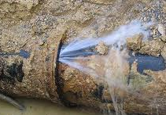
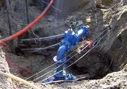
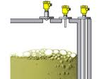
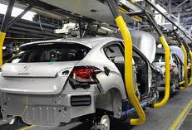
LPWAN Applications
SMART ENVIRONMENT & INDUSTRIAL
SMART METERING
SMART CITY
Electric
Water
Gas
Infrastructure & production
Smart parking
Traffic sensors & control
Street lighting
Infrastructure monitoring
Trash and waste containers
Public events –location services
Advertising displays
Forest fires
Air pollution
Earthquake sensors
Avalanche and flooding
Heating and AC
Equipment status
Factory control
TRACKING
SECURITY/ SMART HOME
Motor bikes
Cars
Bicycles
Kids
Pets
Insurance – valuable assets
Find My Stuff
Smoke detectors
Security systems
Smart appliances
Heating control / monitoring
AGRICULTURE
Irrigation control
Environment sensing
Animal tracking
Animal sensing – ovulation, birth

Slide 7

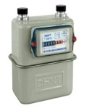
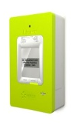
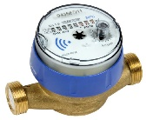

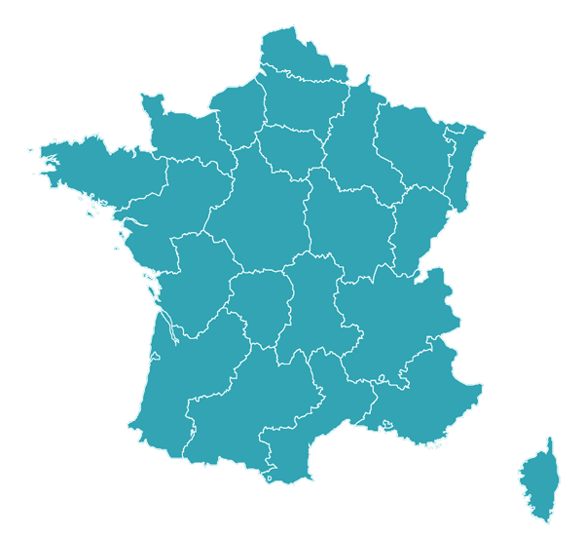


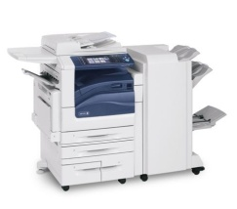
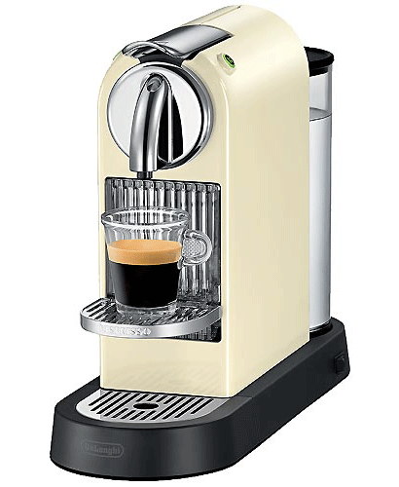
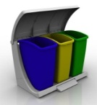
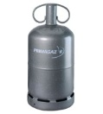
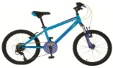

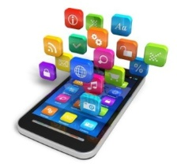

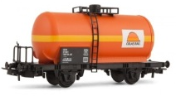
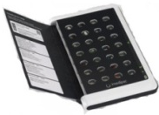
Nationwide Networks Deploying
Applications are many:
Metering
Supply chain management
Maintenance / Supervision
Alerting
Identification / géolocalisation
Back up for GSM existing solutions
Public Annoucements of Deployments by:
Fastnet (Telkom South Africa)
KPN (Holland)
Proximus (Belgacom) (Belgium)
Swisscom (Switzerland)
Bouygues (France)
Senet (USA)
Lace (Russia)

Slide 8

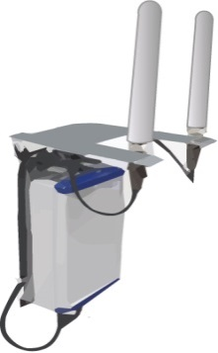

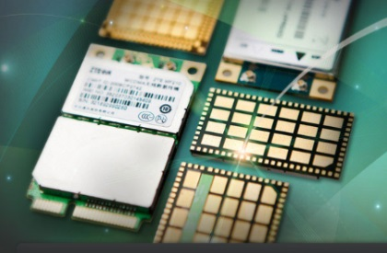
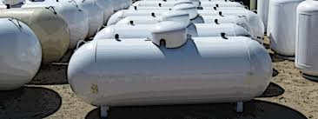
What is LoRa?
Long Range Gateway IC
Long Range Node IC
Range >cellular at fraction of power
Application
App
MAC Protocol
LoRaWAN
PHY
LoRa
= 5-10 year battery life
= 5x lower sensor cost than cellular

Slide 9



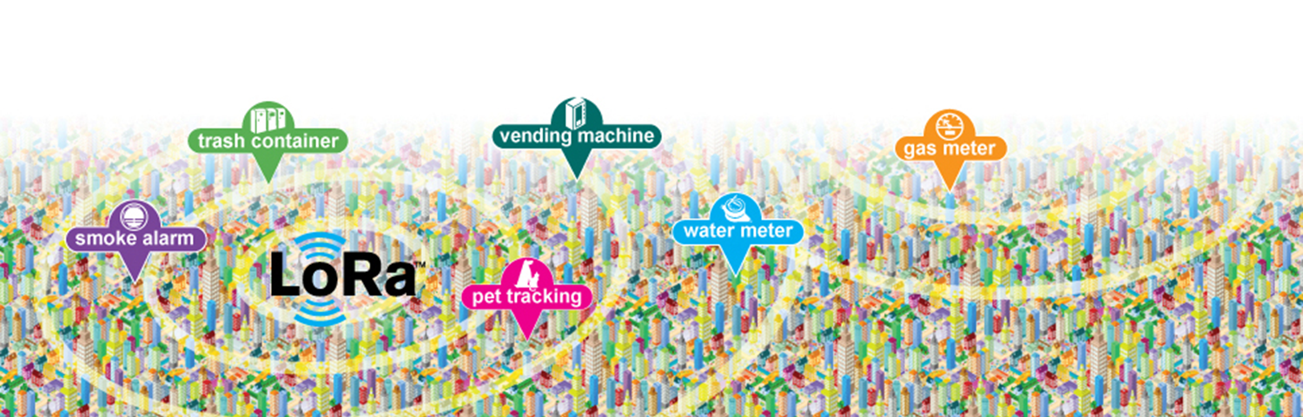
LoRa™ Network Features
Long Range
Greater than cellular
Deep indoor coverage
Star topology
Max Lifetime
Low power optimized
10-20yr lifetime
>10x vs cellular M2M
Multi-Usage
High capacity
Multi-tenant
Public network
Low Cost
Minimal infrastructure
Low cost end-node
Open SW

Slide 10

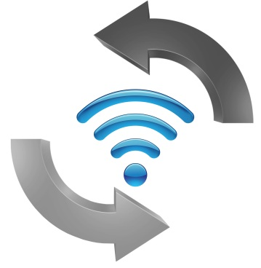


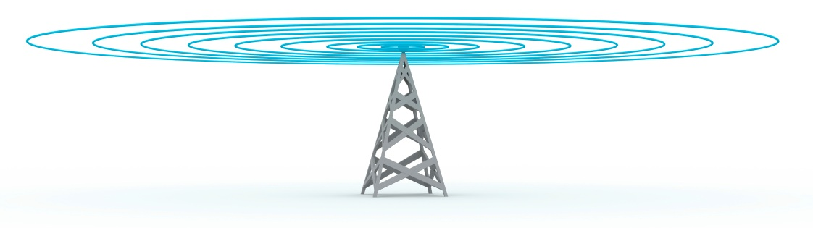
LoRaWAN Differentiation and Benefits
True Location
In/out door
Accurate
Bidirectional
Bidirectional
Scalable Capacity
Broadcast
Global Mobility
True Mobility
Seamless
Roaming
Security
Unique ID
Application
Network
www.LoRa-Alliance.org

Slide 11
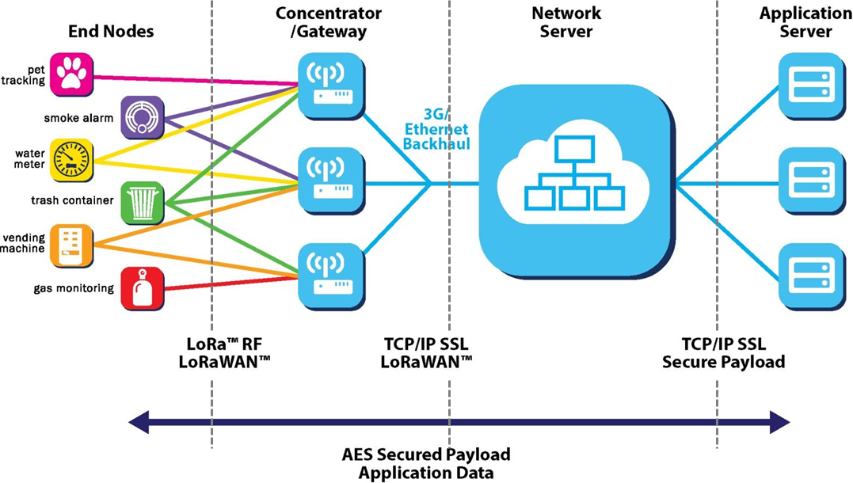
LoRaWAN System
Long range star network (same architecture as cellular)
Easy to deploy/maintain, reduces cost of infrastructure, optimizes battery lifetime
Public or Multi-tenant networks managed by major telecom companies
Enables customers to focus on end-node design/application not network management
Reduces costs and complexity for all segments of the market

Slide 12


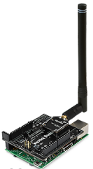
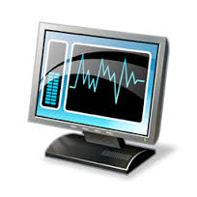
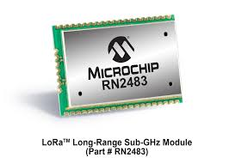

LoRaWAN Segments and Ecosystem
Public Network Operator
Private Network Operator
SX127X family
Modules
Sensors
Base station
Network Server
Application Server
SX1301
Transceiver

Slide 13
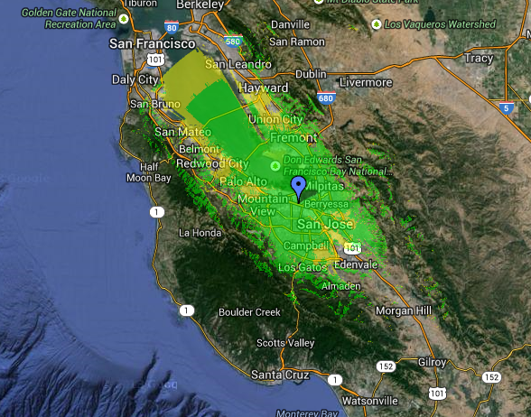
LoRa Range and Coverage
Coverage map from a single gateway/concentrator
Cisco Webex building in San Jose
>30miles from San Jose to San Bruno

Slide 14

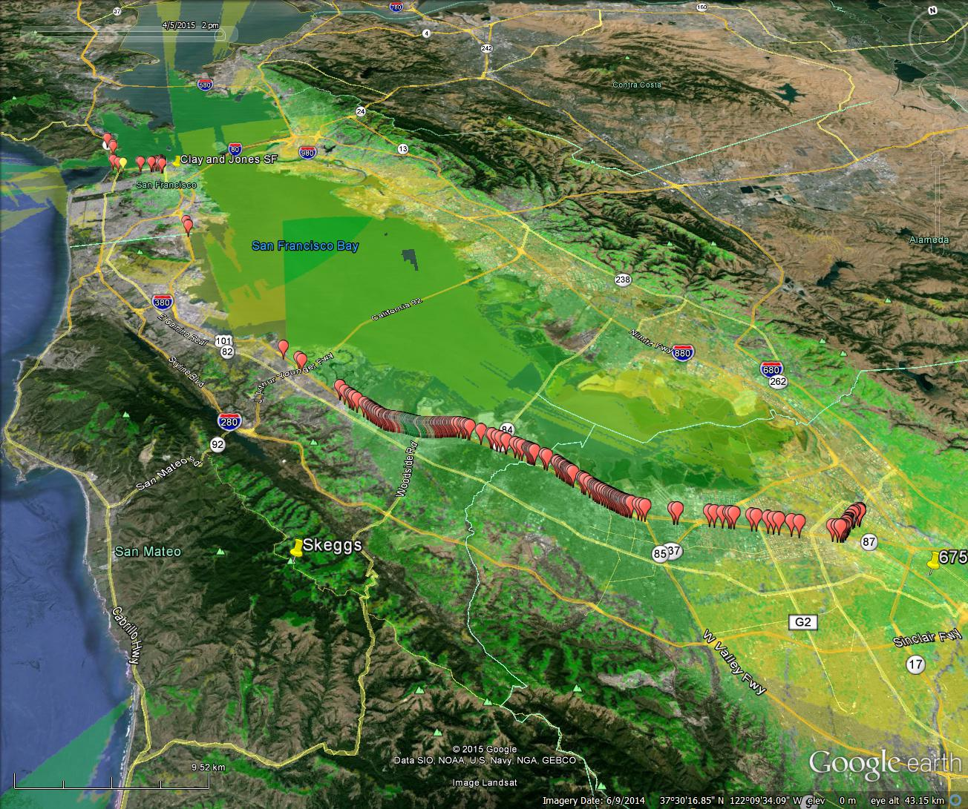
Senet Silicon Valley Network
Three Senet towers deployed in Silicon Valley
Coverage map from three Senet towers (Joe’s drive home)
Tower 1:
Clay St, SFO
Tower: 2
Skeggs Peak
Tower 3:
North 1st, SJC

Slide 15
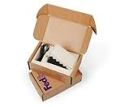
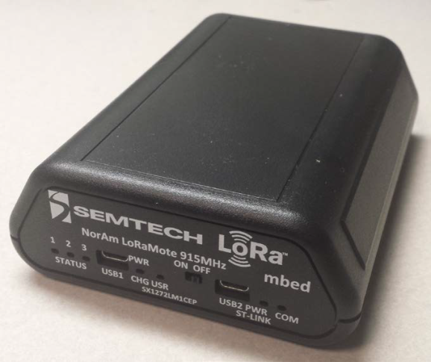

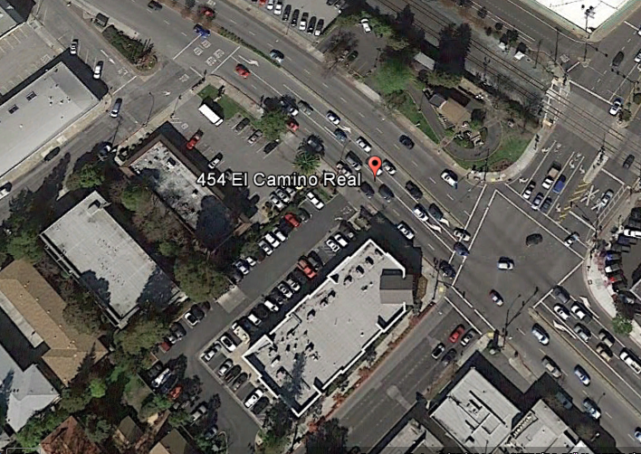
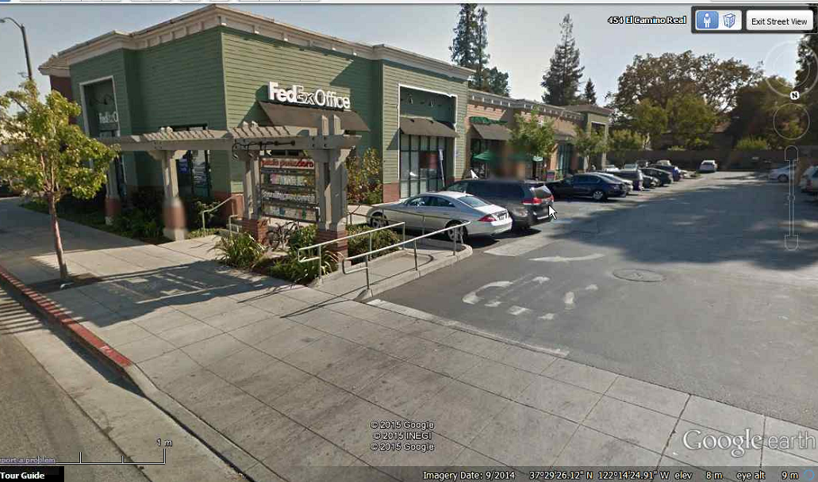

FedEx Experiment:
LoRa for LP WAN Asset Tracking
LoRa Mote
4/21/15 (5:00 pm)
LoRa Mote is dropped off / joins network
Fed Ex Office: 454 El Camino Real, Redwood City CA

Slide 16

FedEx Experiment:
LoRa for LP WAN Asset Tracking
LoRa Mote
4/21/15 (7:10 pm)
LoRa Mote departs on truck
Fed Ex Office: 454 El Camino Real, Redwood City CA
Tower 1:
1st Street SJC
Tower: 2
Skeggs Peak
Data Rate=17 Temp =75F Battery =94%
Tower 3:
Clay Street SFO

Slide 17
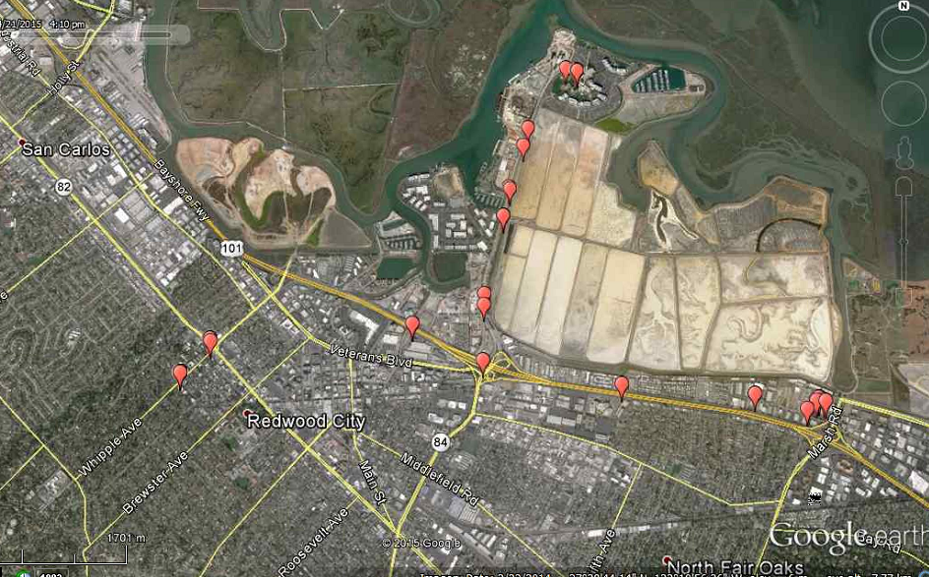

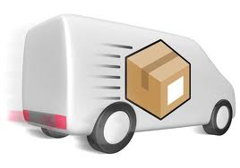
FedEx Experiment:
LoRa for LP WAN Asset Tracking
LoRa Mote
4/21/15 (7:57 pm)
Driver goes to Port of Redwood City
Nearest Tower: 9 Miles / Skeggs Peak
Port of Redwood City
Data Rate=16 Temp= 75.2F Battery =92%
75.2⁰
El Camino Real

Slide 18
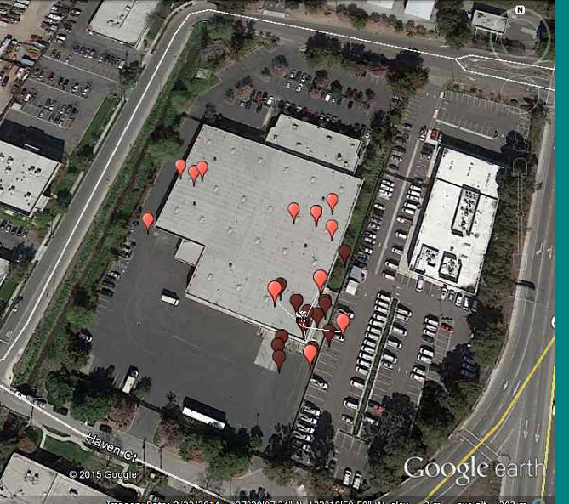

FedEx Experiment:
LoRa for LP WAN Asset Tracking
LoRa Mote
4/21/15 (8:03 pm)
Driver goes to Menlo Park sorting facility
Nearest Tower: 8 Miles / Skeggs Peak
Data Rate=16 Temp= 69.8F Battery =92%
69.8⁰

Slide 19
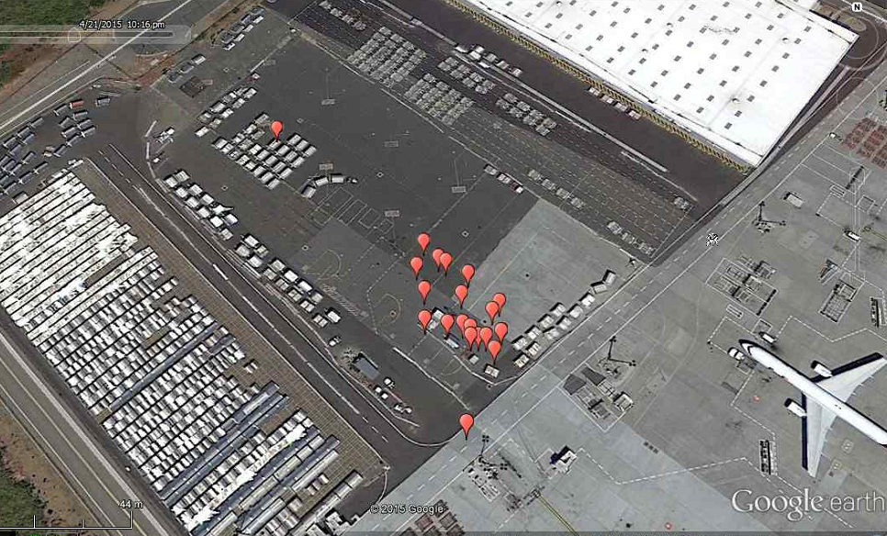


FedEx Experiment:
LoRa for LP WAN Asset Tracking
LoRa Mote
4/21/15 (10:37 pm)
Package spends the night at Oakland Airport on tarmac
Nearest Tower: 11.4 Miles / Clay & Joes St SFO)
Data Rate=16 Temp= 75.2F Battery =90%
75.2⁰

Slide 20



FedEx Experiment:
LoRa for LP WAN Asset Tracking
LoRa Mote
4/22/15 (6:30 am)
Package shows up at SJC sorting facility
Nearest Tower: 2.63 Miles / 675 North 1st Street SJC
Data Rate=16 Temp= 66.2F Battery =86%
66.2⁰
4/22/15 (7:47 am)
Package moves across
warehouse

Slide 21



FedEx Experiment:
LoRa for LP WAN Asset Tracking
LoRa Mote
4/22/15 (10:00 am)
Driver arrives at FedEx drop box
Nearest Tower: 2.60 Miles / 675 North 1st Street SJC
2nd Tower reports: 21.0 Miles / Skeggs Peak!
Package accidentally remains on truck in “outgoing” bin
Driver alerted ☺

Slide 22

LoRa Modulation Overview
LoRa utilized a spread spectrum based modulation
Advantages
Demodulate below noise floor – 30dB better than FSK
Better sensitivity than FSK (better Eb/No)
More robust to interference, noise, and jamming
Spreading codes orthogonal – multiple signals can occupy the channel
Tolerant to frequency offsets (unlike DSSS)

Slide 23

LoRa Parameters and Interference Immunity
Parameter | Range | Effect | Change (125kHz)
Spreading Factor (SF) | 7-12 | DR | 300bps – 9.6kbps
 |  | Sensitivity | -138dBm to -121dBm
Bandwidth (BW) | 125K typ 10-500kHz | DR vs sensitivity | 300bps – 22kbps
Error correction | 4/5 to 4/8 | DR, time on air
Freq | 138M-1GHz |  | Frequency agnostic
FSK
Interfere | LoRa Co-Channel | FSK Co-channel
CW/FSK/GFSK | -5 to -20 | +8 to +10
Noise
Level
LoRa

Slide 24
LoRaWAN Device Classes
A
Battery powered sensors
Most energy efficient
Must be supported by all devices
Downlink available only after sensor TX
B
Battery Lifetime
Battery powered actuators
Energy efficient w/ latency controlled downlink
Slotted communication synchronized with a beacon
C
Mains powered actuators
Devices which can afford to listen continuously
No latency for downlink communication
Downlink Network Communication Latency

Slide 25
Bidirectional communication, class A
Receiver Initiated Transmission strategy (RIT)
Packet
End device sleeps
Rx slot 1
Rx slot 2
End Device
Base station
Received by all base stations in range
Cloud MAC Controller selects best base station

Slide 26
Bidirectional communication, class B
Coordinated Sampled Listening (CSL) : Network may send downlink packet to node at any Rx slot
Rx1
Rx1
Rx1
Rx1
Rx1
Rx1
Rx1
Rx1
Rx
2
Rx
3
Rx
4
Rx
5
Rx
x
Rx
x
Rx
x
Rx1
End Device
BEACON
BEACON
128 seconds
Base station
Received by all base stations in range
Cloud MAC Controller selects best base station

Slide 27

Adaptive Data Rate (ADR) 2D case, flat landscape
2D simulation (flat environment)
14km
10km
8km
6km
4km
Bitrate
Energy / Time on air
Avg bitrate ~1300bps
290bps
530
970
SF12
11
10
9
8
7

Slide 28










Network Capacity Optimization
G1
G2
LoRa Adaptive Data-Rate
Optimizes channel usage
Enlarges G1 capacity
Saves battery
Let free G1 capacity
S6
S5
S2
More capacity : New end-points
available on G1
(deep indoor)
(indoor)
(outdoor)
(outdoor)
(indoor)
(deep indoor)
(outdoor)
S6
S6
S5
S5
S6
S4
S3
S1
S2
S1

Slide 29

Current LoRaWAN Spec for North Amer.
Currently fixed channel plan with
64 channels at 125 KHz uplink
8 channels at 500 KHz uplink
8 channels at 500 KHz downlink
Data rates for 125 KHz channels are SF7 to SF10
Maximum conducted power for uplink is 1W

Slide 30

Wrap Up and Next Steps
LoRaTM enables the Internet of Things
Disruptive technology for IoT and tracking of assets
Provides outdoor and deep indoor connectivity
Very low cost of ownership with private or nationwide network deployments
Scalable architecture makes it future proof for capacity and interference
Strong ecosystem of partners and applications

