Slide 1
LoRaWAN Sensor Example
23-July-2015

Slide 2
Goals
Demonstrate how to connect to Senet LoRaWAN network.
Send data via Senet network to IoT data storage M2X
Implement a If-This-Then-That (IFTT) trigger to send a response from M2X to the device (mDot)
Receive and process data at the device (mDot)

Slide 3


LoRaWAN Uplink information flow
LoRaWAN
Gateway
Senet Co.
Network Server
Application Server
Check Device ID
Msg MIC Check
Duplicate Filter
Decode Packet
Fwd to App Owner
M2X
Data Storage
Visualization
IFTT Trigger
LoRaWAN Device pre-programmed with ID and Routing Parameters.
DevEUI = Device ID, e.g. SSN AppEUI = Application ID, e.g. Employer AppKey = Encryption Key, e.g. ID Badge

Slide 4
LoRaWAN Downlink information flow
LoRaWAN
Gateway
Senet Co.
Network Server
Application Server
Choose Tower
Queue Msg at Tower
Encrypt Packet
Queue Packet
M2X
IFTT Trigger calls
Senet URL
LoRaWAN Device
Already JOINED

Slide 5

Confirm Senet Account
Skip ahead only if you have completed setting up your Senet Account

Slide 6
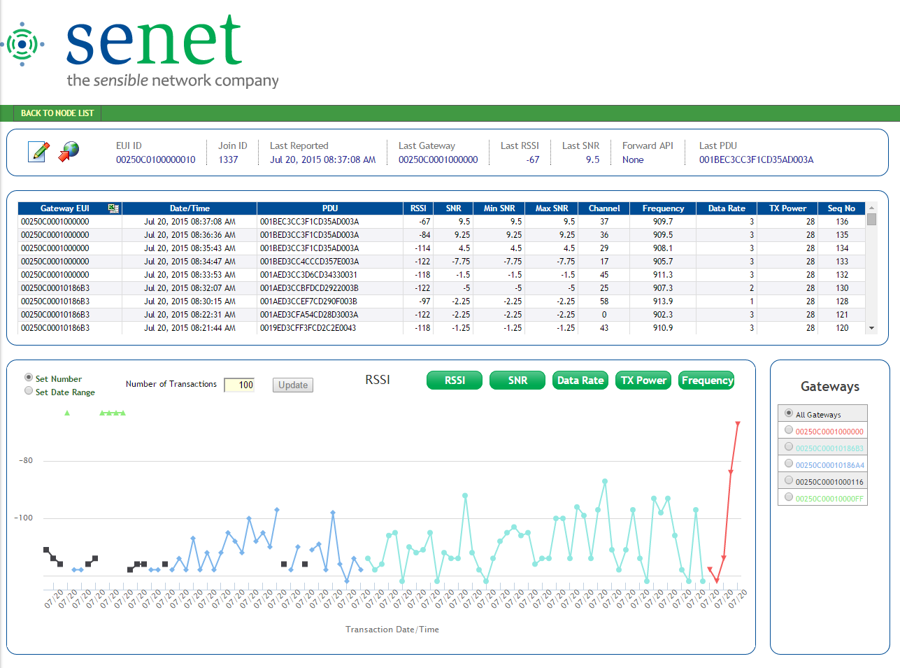
LoRaWAN Developer Portal
Developer login
Manage test devices
Transaction visibility
PDU
RF Attributes
Transaction forwarding
Raw JSON
ATT M2X
Initiate downlink communications
Export to CVS
http://app.senetco.com/senetdev

Slide 7
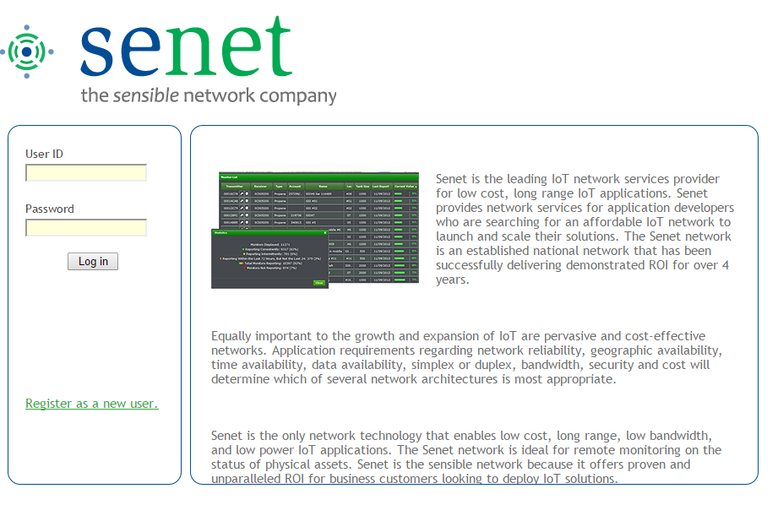
Senet Developer Portal – Login Page
Begin registration process

Slide 8
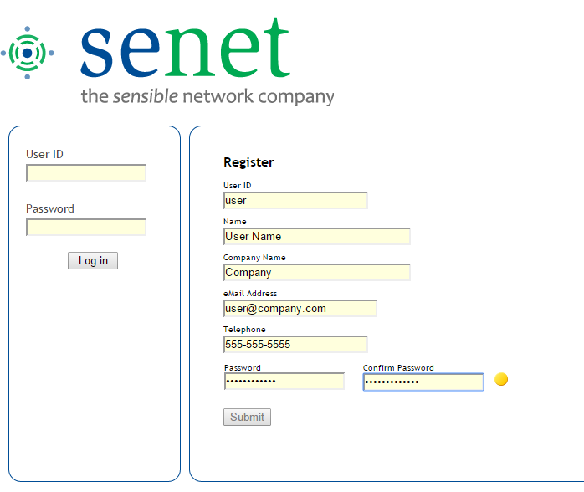
Senet Developer Portal – User Registration
Complete registration process

Slide 9
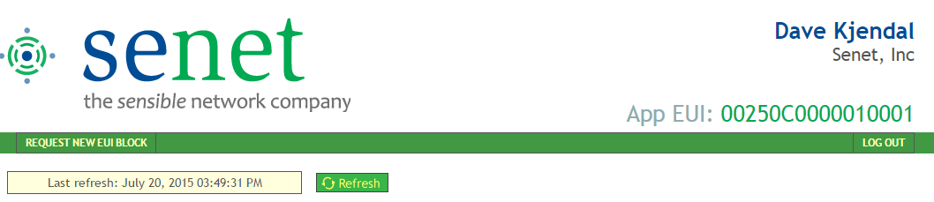
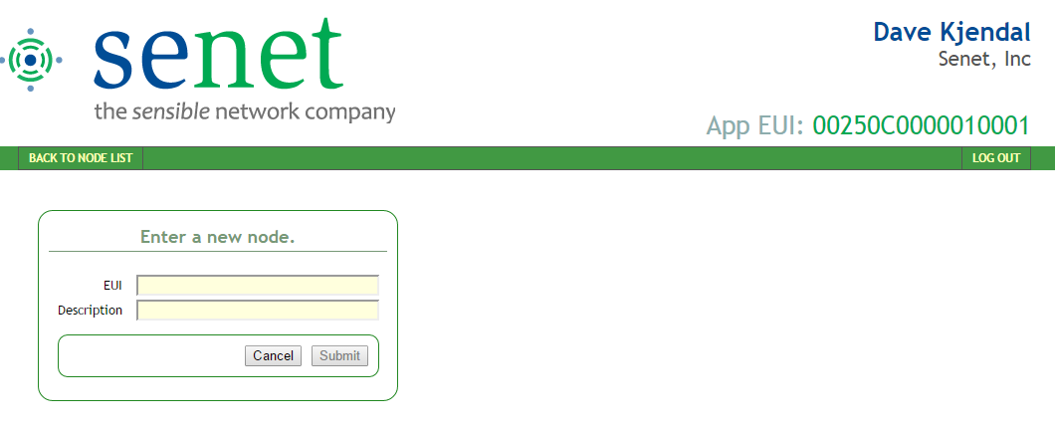
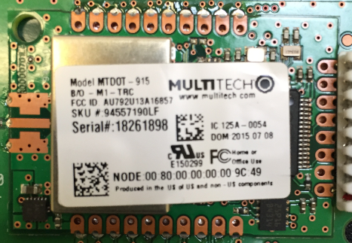
Senet Developer Portal – New Device Registration
Register a new device
Device EUI from mDot sticker

Slide 10
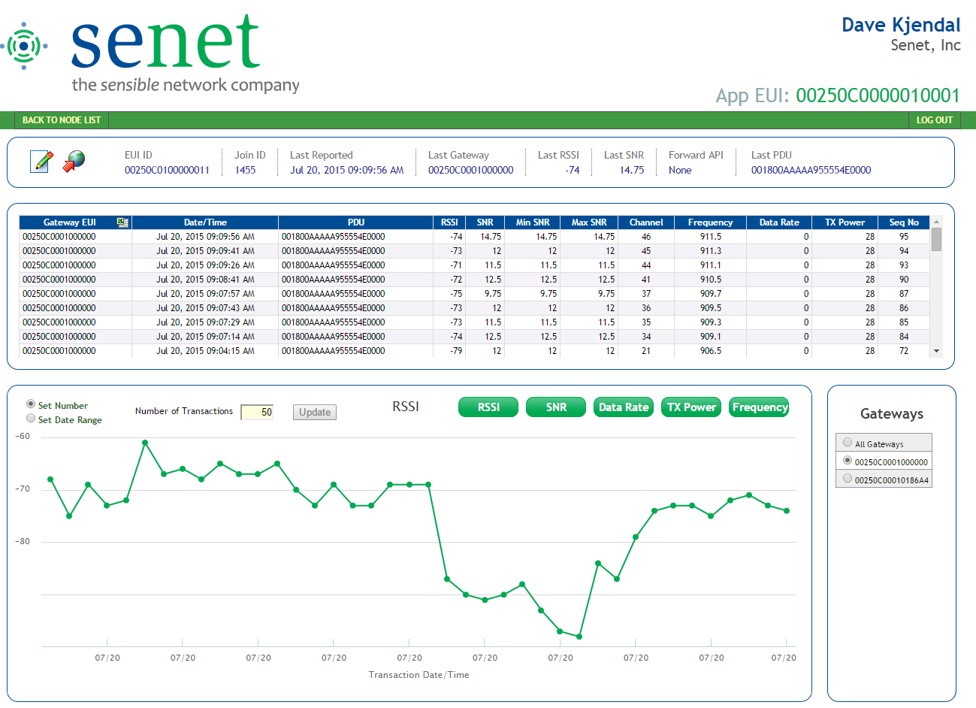
Senet Developer Portal – Device Detail
Configure Device
Send Downlink
Export to CSV
Set Data Range (display and export)

Slide 11

Resume mDot Lab

Slide 12



Import the Reference Project
From the following link import the project into your mbed workspace.
https://developer.mbed.org/teams/Semtech/code/MTDOT_Senet_Demo_23-July
This project implements a simply tilt detector that can be used to report the Open or Close status of a garage door or mail box door.

Slide 13
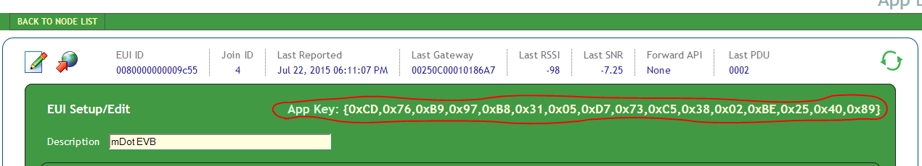
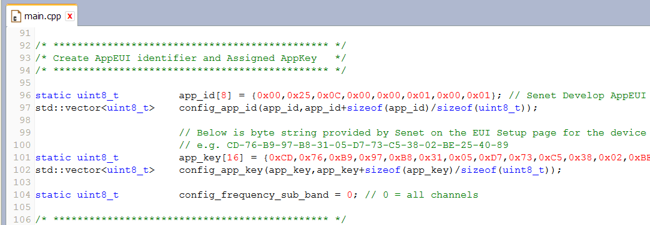
Update the project for your mDot
Update the AppKey on line #101 of main.cpp with the AppKey provided by Senet.

Slide 14
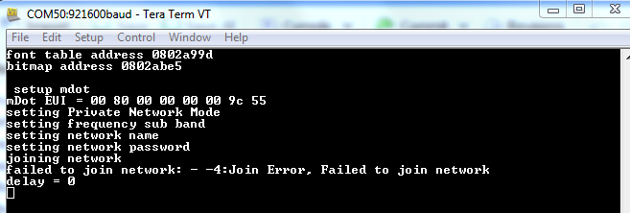
Compile and Download your code
If we have updated everything correctly the project should compile without Error.
Make certain that you have the Virtual Comm Port active.
Baud rate is 921600
Download the code to your mDot. (Drag to Multitech drive.)
You should see some messages indicating that your device has successfully connected to the Senet Network
It is normal for the device to fail to ‘Join’ once or twice.

Slide 15
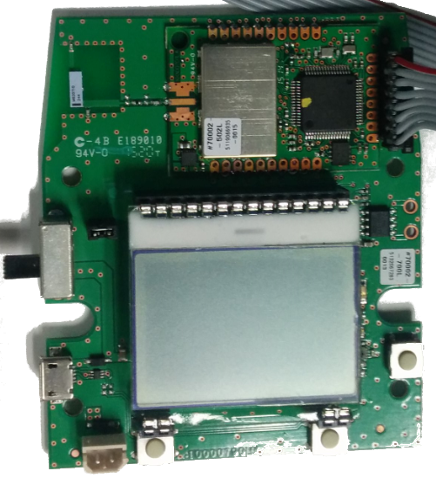
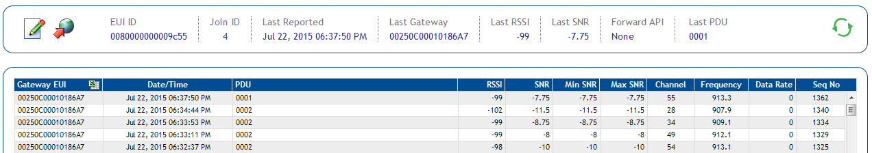
Logging Data
Change the Orientation of your device.
Observe the data being saved on the Senet Developer Site.
0001 == Flat
0002 == Vertical

Slide 16
Confirm M2X Account
Skip ahead only if you have completed setting up your M2X account

Slide 17
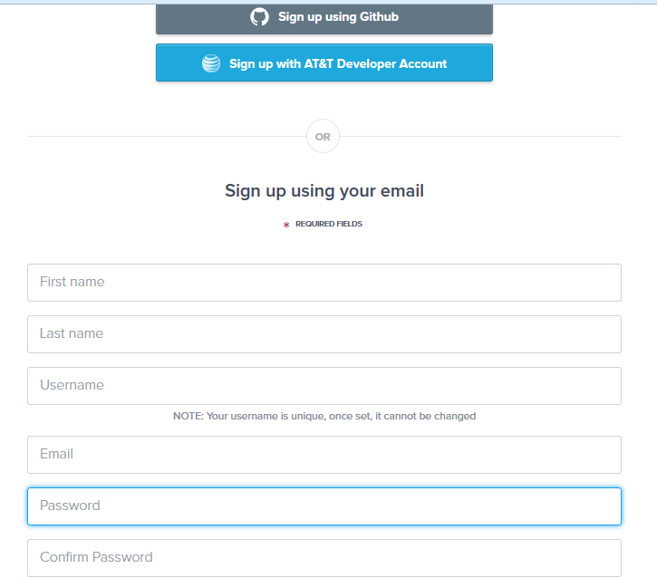
M2X Sign-Up
Goto:
https://m2x.att.com/signup
Sign up by using other accounts or enter the required fields
Select “SIGN UP” at the bottom of the page
If you use email you will need to confirm by following the link provided in the M2X activation email.

Slide 18
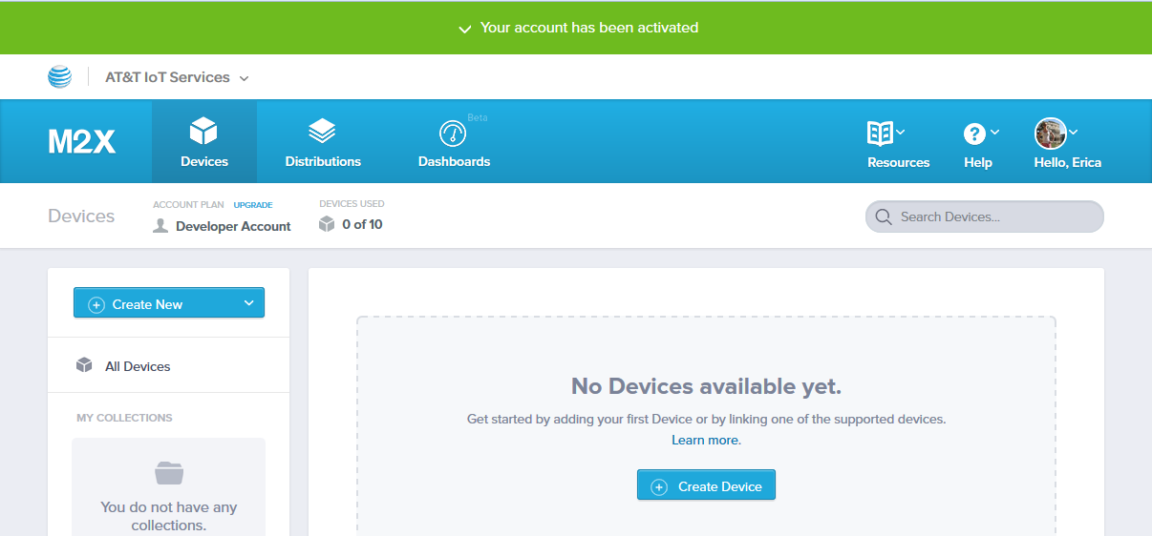
M2X Account Activated
When your account is activated you should see a web page that allows you to create a new device.

Slide 19
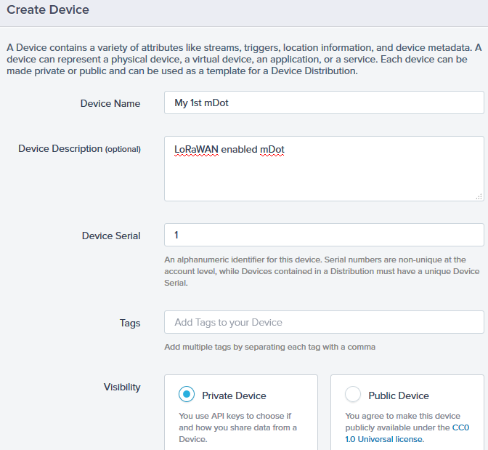
Create your device
Create your first device as shown to the right.
When done entering the fields select “Create” at the bottom of the page.

Slide 20
Create a stream for your data
Start by selecting “Add Stream” as shown below.

Slide 21
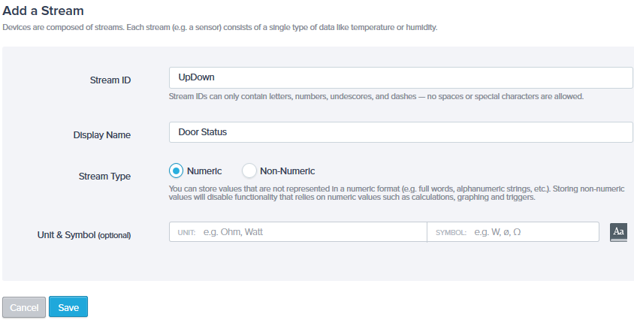
Add stream information
Add a unique stream ID. Use, “UpDown” as shown below.
Add a convenient Display Name. Perhaps “Door Status”.
Click “Save” to create and save this stream.

Slide 22
Resume mDot Lab

Slide 23
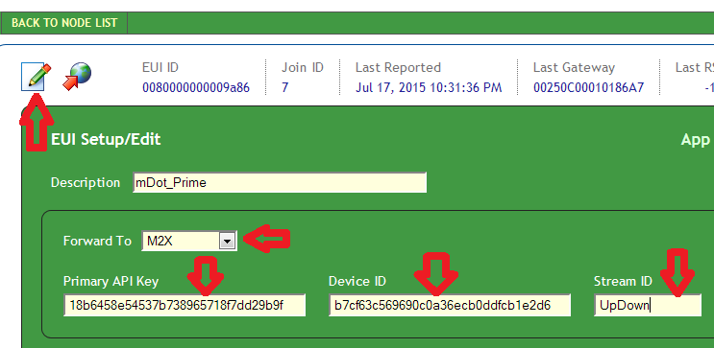
Forward to M2X from Senet Account
Login to Senet account and select the node.
Select the EUI Setup button (paper with pen icon)
Enter a description and select “Forward to M2X”
Copy from the M2X account the Primary API key
Copy from M2X the Device ID
Enter the stream ID of “UpDown”
2
3
6
4
5
5
4

Slide 24
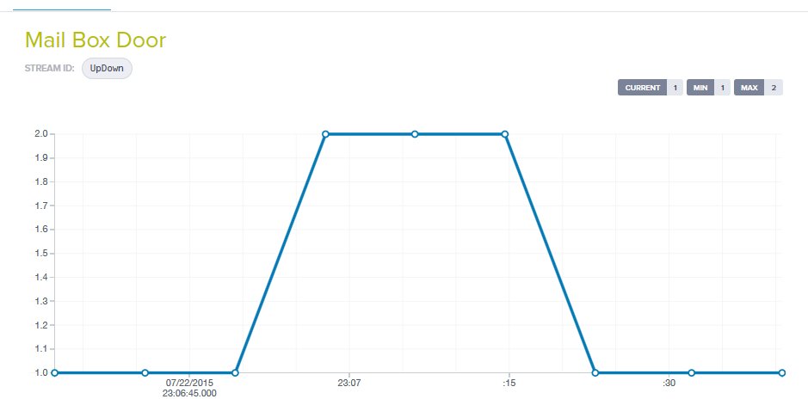
Logging Data at M2X
Change the Orientation of your device.
Observe the data being saved on the M2X Site.
2 == Tilted Up
1 == Flat

Slide 25
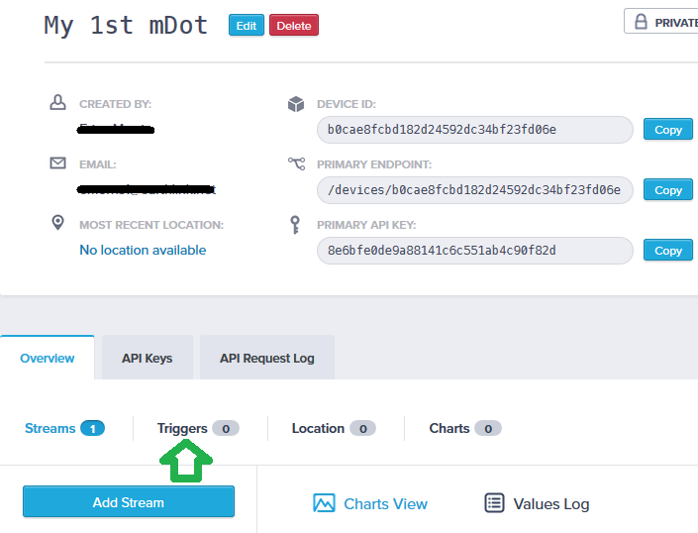
Create a trigger (Turn on Light when Up)
From your M2X account create a trigger by selecting Triggers on the device page.

Slide 26
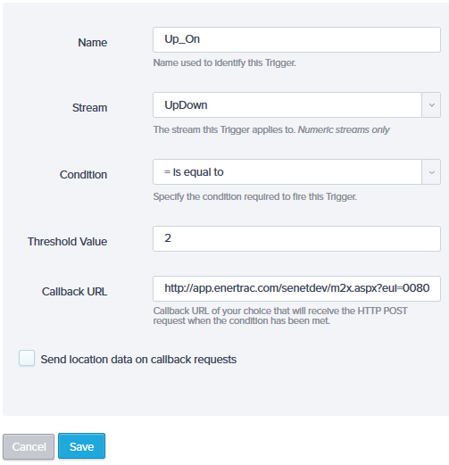
Trigger Details (Light On when Up)
Enter the fields as shown to the right.
The Callback URL will enable M2X to send a message to your mDot.
The Callback URL details are on the following page.
Press “Save” after entering the customer Callback details.

Slide 27
Callback URL
A Callback URL is required by the trigger to enable an action to take place when the condition specified by the trigger is satisfied.
In order to send a message to your mDot while connected to the Senet network the following URL is customized
http://app.enertrac.com/senetdev/m2x.aspx?eui=[YourEUI]&port=1&user=[UserName]&value=0F
Replace [YourEUI] with the DevEUI (008000000000xxxx) of your mDot.
(Do not include the “[“ or “]” in your URL.)
Replace [UserName] with your Senet account user name.
(Do not include the “[“ or “]” in your URL.)
E.g.
http://app.enertrac.com/senetdev/m2x.aspx?eui=0080000000009C55&port=1&user=jknapp&value=0F

Slide 28
Create 2nd Trigger (Off when down)
Create a second trigger using same fields but different
Test condition
Callback URL
Test Condition is “Equal to” == 1
Copy the previous Calback URL and change the value paramter to zero hex, 00
http://app.enertrac.com/senetdev/m2x.aspx?eui=00250C0100000283&port=1&user=jknapp&value=00

Slide 29
Put it all together
When the previous configuration is combined with the example UpDown mDot application a change in the condition of the mDot should be recorded by M2X and an appropriate message sent back to the mDot. The mDot receives the downlink data and turns its blue LED “On” or “Off”.

