Slide 1
LAB Overview mbed Instructions for MultiTech mDot Semtech/ARM/MultiTech/Att/Semtech /AT&T M2X

Slide 2
Lab Overview
Labs
Lab1: Setting up the system.
Lab2: Getting Started
Lab3: Back to Normal
Lab4: LoRa Public Network Access: Senet
Lab5: Getting to a Cloud via Private Network

Slide 3
LAB 1 mbed Setup Instructions

Slide 4
Lab Overview
Setup/Downloads
Serial program
mbed account
Driver from ST
Software downloads

Slide 5
Serial Port Install Software
If you prefer Putty or another USB to serial solution please use it.
Install TeraTerm or similar Serial program.
http://ttssh2.sourceforge.jp/index.html.en
Click on the “download page”
Run “teraterm-4.87.exe” accept the defaults

Slide 6
Windows Driver update
On https://developer.mbed.org/platforms/MTS-mDot-F411/
Slide down the page till “PC Configuration”
Click on “ST Link Driver” or use the below link https://developer.mbed.org/teams/st/wiki/ST-Link-Driver
“ST Link Driver” is now open.
Download “Download ST-Link/V2 driver”
Extract the zip file to a known location.
Depending on your machine, Run either dpinst_amd64.exe (for 64 bit system) or dpinst_x86.exe (for 32 bit). (As a reference: Window Button, Control Panel, System)

Slide 7
Mac/Linux Serial Port
Mac and Linux Steps:
Follow the on line instrutions: https://developer.mbed.org/platforms/MTS-mDot-F411/

Slide 8
Setup mbed Account and Add Platform
Go to developer.mbed.org
Sign-up and/or log-in (no instructions provided)
Add a Platform to mbed
(From www.mbed.org) Click on Developer(top), Platforms(top), MultiTech(Right side), Click on MultiTech mDot. Or Go to https://developer.mbed.org/platforms/MTS-mDot-F411/
Click on the blue box “Add to your mbed Compiler” (right side)

Slide 9
Alternative Technique to add a Platform
In a Browser go to www.mbed.org
Click on “Developer Site”
Select “Compiler”
Click on (top right) “No Selected” or “Platform you already have setup”
Click “MultiTech mDot”(bottom) and “Select Platform” (top corner).
Bonus: you may add an additional platforms by clicking on “Add Platform”

Slide 10
Processor Firmware Update (Missing Homework)
The following procedure can be used to update the CPU with new firmware.
Update your mDot board to the latest firmware https://developer.mbed.org/teams/ST/wiki/Nucleo-Firmware Web page “Nucleo Firmware”
Click on “Download the latest ST-LINK/V2-1 firmware upgrade”.
Download, Extract and Run “STSW-LINK007”
Plug the power to Developer board then USB cable.
Wait for USB Enumeration to finish. Click “Refresh device list”
Click “Open in update mode”
If needed, Click “Upgrade”. As of 2015/07/21 Version 11
After success Close the program.

Slide 11
Programs to download
Click on the Links and “Import this program” (Blue Box Right side).
Alt Tab to mbed Workspace . The computer is waiting for a program name to finish the install.
Click “Import” in mbed Workspace.
Hello World Program: https://developer.mbed.org/teams/MultiTech/code/mDot_helloworld/?platform=MTS-mDot-F411
libmDot_sample:
https://developer.mbed.org/teams/MultiTech/code/libmDot_sample/?platform=MTS-mDot-F411
AT Command Line Demo:
https://developer.mbed.org/teams/MultiTech/code/mDot_AT_firmware/?platform=MTS-mDot-F411
EVB standalone Demo:
https://developer.mbed.org/teams/Multi-Hackers/code/MTDOT-EVBDemo/

Slide 12
Programs not sent in Homework
Click on the Links and “Import this program” (Blue Box Right side).
Alt Tab to mbed Workspace . The computer is waiting for a program name to finish the install.
Click “Import” in mbed Workspace.
Senet / Semtech Public LoRa Network mDot-EVB
https://developer.mbed.org/teams/Semtech/code/MTDOT_Senet_Demo_23-July/
Private network LoRa mDot-EVB
https://developer.mbed.org/users/jamescmaki/code/mDotEVBM2X/

Slide 13
LAB 2 Getting Started mDot.box / Sensor/ Conduit Gateway

Slide 14
Lab Overview
Lab 2
What do I have?
Hello World
AT Commands
mDot-EVB Sensor

Slide 15
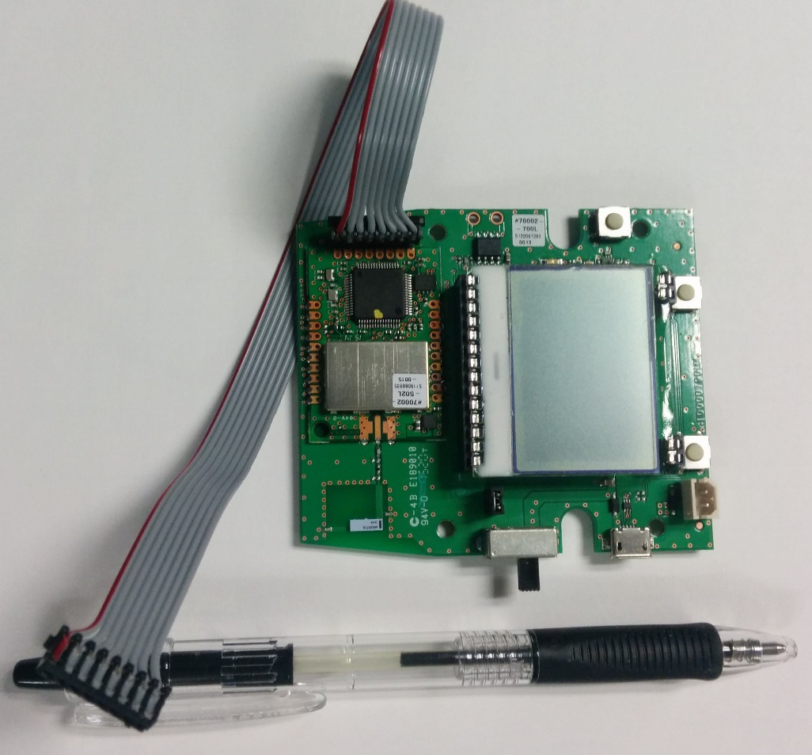

Slide 16
Features and Descriptions
User Programmable LEDs
Two User Programmable Push Buttons, one reset
External Power Connector (remove the jumper)
JTAG SWD programming interface on MTDOT
Graphic LCD Display, optional backlight capability
USB 2.0 Micro B connector, “Full Speed”
Chip Antenna

Slide 17
Sensors
Ambient Light Sensor: Intersil: ISL29011
Accelerometer: Freescale: MMA845x
Absolute Pressure and Temp: Freescale: MPL3115A2
I2C LED Driver: On Semi: NCP5623B
Display: LCD-Module: DOGS102
(Current Sensor)

Slide 18
Optional 12 pin header
Pin | Function | Function | Pin
1 | GROUND | MDOT_SOUT | 2
3 | SPI_MISO | MDOT_SIN | 4
5 | SPI_MOSI | I2C_SDA | 6
7 | SPI_SCK | I2C_SCL | 8
9 | SPI_NCS | VDD_EXT | 10
11 | GROUND | EXT_ADC_IN | 12

Slide 19
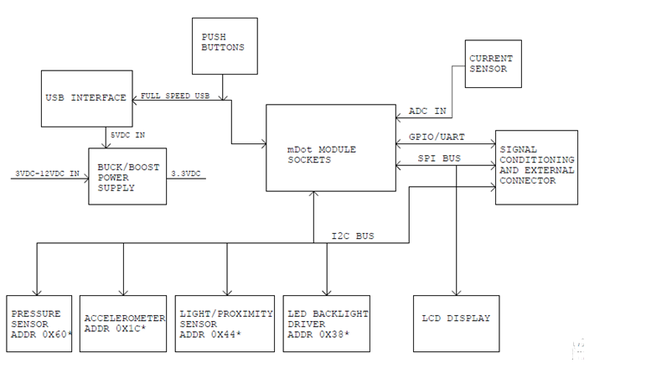
mDot-EVB Block Diagram

Slide 20
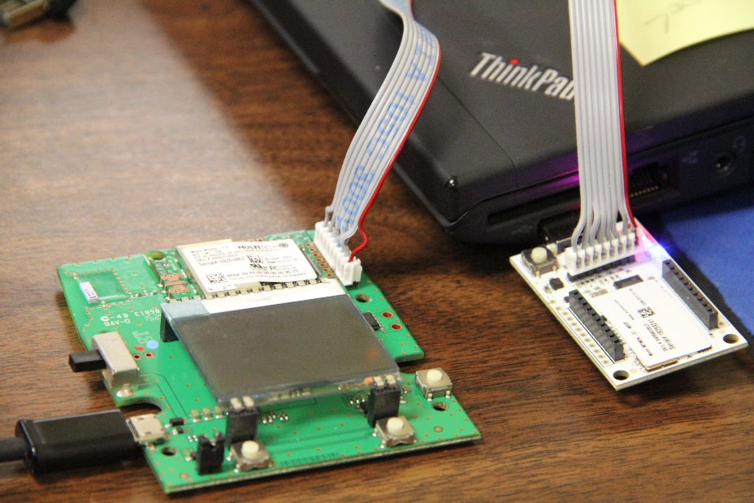
Power
Apply Power to mDOT-EVB from USB Port
Play …..
Attach grey cable, Insert micro UDK to USB
Wait.… Device drivers may take a period of time to load. A MULTITECH Drive should appear.
*** IF the drive is 20K, reseat the grey cable***
Login to mbed.org,
Click “Developer” then Click “Compiler”.
Beta Mode
Open https://developer.mbed.org/betamode/?pre=newboards
Click on blue box “Beta Mode” end of page
Go back to mbed.org, Click on Developer, Click on Compiler. You should see Beta Mode in top right corner
Red wire on the right
Pin 1 - Square Pad

Slide 21
Hello World
Yes it’s silly, but lets get the LED to blink and test TeraTerm.
In mbed.org session. (home, compiler, verify the right board is there).
in mbed Workspace Manager aka compiler https://developer.mbed.org/compiler
Double Click “mDot-helloworld”
Double Click on main.cpp
Modify Line 15 it should read “DigitalOut led(PB_0);”
Click on Compile, Save the file to your favorite location, Open the download folder
Right Click and Send the new file to the MULTITECH Drive:. The RG LED on the micro UDK should be on for a few seconds during the download process.
Start Teraterm, Click on Serial, Select the right PORT “STMicroelectornics STLinkVirtual COM Port”.
Settings: Setup, Serial, values are: Baud rate: 9600, Data: 8, Parity: N, Stop: 1,Flow: none.
You should see Hello World! Every 2 seconds. You can adjust variables in Main.cpp.

Slide 22
Modify Hello World
Yes it’s still silly, but lets get the text to change.
Change the text from Hello World to something else
Modify the code as you see fit
Click on Compile, Save the file to your favorite location, Open the download folder
Right Click and Send the new file to the MULTITECH Drive:. The RG LED should be on for a few seconds during the download process. LEDs should be blinking.
Start Teraterm, Click on Serial, Select the right PORT “STMicroelectornics STLinkVirtual COM Port”.
Settings: Setup, Serial, values are: Baud rate: 9600, Data: 8, Parity: N, Stop: 1,Flow: none.
You should see Hello World! Every 5 seconds. You can adjust variables in Main.cpp.

Slide 23
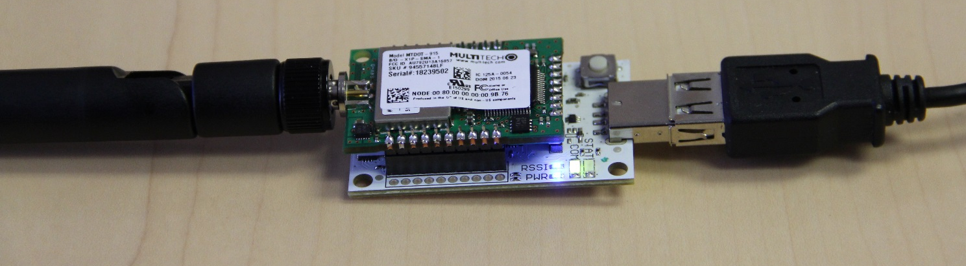
Reference Only: Get the Modem on the LoRa Network
AT Commands are still valid.
Tasks
Set up the Keys, Spread Factor.
Verify settings
Join a network
Signal strength

Slide 24
Reference Only: AT Commands to a Gateway
Go to web address www.multitech.net
Click on the picture “MultiConnect mDots”
Toward the bottom of the page ‘Using the mDot’. Click on “mDot Software”
Click on “Upgrading mDot Firmware”
With mDot-EVB JTAG attached to Micro UDK, Power mDot-EVB, then Attach Micro UDK to a USB port
Save “Download version 0.0.14” to hard drive or mDot.
Program mDot.

Slide 25
Reference Only: AT Commands
Start Teraterm,
Click on Serial, Select Serial Port “XR21V1410 USB UART”,
Settings: Setup, Serial, values are: Baud rate: 115200(serial) Data: 8, Parity: N, Stop: 1,Flow: none. ECHO may need to be turned On (Terminal)
Type “AT” you should get an ok.
Type “?” you get a list of commands (try a full screen window)
Type “AT+FSB=3” This determines what LoRa Frequency Sub Band
Do not type“AT+FREQ=915” This is the default and no need to enter the data.
Type “AT+nk=1,???????” ??? Is your Network Key you assign

Slide 26
Reference Only: AT Commands
Type “AT+NK=1,???????” Is your Network ID you assign
Type “AT&V” You will get a screen full of data to decode.
Type “AT&W” You have written the parametrics into Flash
Type “AT&I” shows the version.
Type “ATZ” You will get a screen full of data to decode.
Type “AT+JOIN” you should get a good response
Type “AT+RSSI” provides the signal strength
Optional: By changing the settings to Public you can see the Senet Network.

Slide 27
Why did I spend all that time with AT Commands?

Slide 28
LAB 3 Back to Normal

Slide 29
Get the system back in working order
in mbed Workspace Manager aka compiler https://developer.mbed.org/compiler
Double Click mDot-EVBDemo
Modify Lines
Modify Line 102: = “Jaeger123";
Modify Line 103: = " Jaeger123 ";
Modify Line 104: frequency_sub_band = 3;
Click on Compile, Save the file to your favorite location, Open the download folder
Right Click and Send the new file to the MULTITECH Drive:. The RG LED should be on for a few seconds during the download process. LEDs should be blinking.
Start Teraterm, Click on Serial, Select the right PORT.
Settings: Setup, Serial, values are: Baud rate: 921600, Data: 8, Parity: N, Stop: 1,Flow: none.
You should see Hello World! Every 5 seconds. You can adjust variables in Main.cpp.

Slide 30
Get the system back in working order
in mbed Workspace Manager aka compiler https://developer.mbed.org/compiler
Double Click mDot-EVBDemo
Click on Compile, Save the file to your favorite location, Open the download folder
Right Click and Send the new file to the MULTITECH Drive:. The RG LED should be on for a few seconds during the download process. LEDs should be blinking.
The device currently is looking for a LoRa network to attach to and therefore the fast blink LED.
Start Teraterm, Click on Serial, Select the right PORT.
Settings: Setup, Serial, values are: Baud rate: 921600, Data: 8, Parity: N, Stop: 1,Flow: none.
You should see Hello World! Every 5 seconds. You can adjust variables in Main.cpp.

Slide 31
LAB 4 Public Network Access Attaching to Senet

Slide 32
LAB 4: Senet Public Gateway
Tasks
Download the Program
Modify settings
Add credentials
Examine data on Cloud
Modify code for more sensor data and graphs.

Slide 33
LAB 5 Getting to a Cloud via Private Network mDot.box/ Sensor/ Conduit/ M2X AT&T

Slide 34
Create a login and Containers for AT&T
Use the Login from Lab 4 to M2X
Create the following Streams: temperature, unit degree Celcius. barometer-pa, unit pascal (Pa) light-lux, unit lux (ls) accelerometer-z accelerometer-y accelerometer-x

Slide 35
Create a login and Containers for AT&T
In mbed Complier Double Click on mDotEVBM2X and Open main
Modify Line 57 frequency_sub_band = 3;
Modify Lines 64 and 65 config_network_name = "Jaeger123"; config_network_pass = "Jaeger123";
Modify Line 82 and 83 with the correct data from your M2X account m2x_device = “***From your account***"; m2x_key = “***From your account***";
Compile, Download, Run the code
Verify your device is changing the graphs on M2X

Slide 36
LAB Review Where to find/Is it repeatable/What do you need?

Slide 37
MTDOT pin function mapping
 |  |  |  |  |  |  |  |  |  | Doc Rev 0.1 tab | 5/8/2015
mDOT Pin | 5V tolerant (1,2) | GPIO | SWD Interface | SPI Interface | I2C Interface | USARTs | Timer functions | RTC Functions | USB Interface | Event Trigger output | ADC Channels (3)
2 | Yes | PA2 |  |  |  | USART2_TX | TIM2_CH3, TIM5_CH3, TIM9_CH1 |  |  | EVENTOUT | ADC1_2
3 | Yes | PA3 |  |  |  | USART2_RX | TIM2_CH4, TIM5_CH4, TIM9_CH2 |  |  | EVENTOUT | ADC1_3
4 | Yes | PA6 |  | SPI1_MISO |  |  | TIM1_BKIN, TIM3_CH1 |  |  | EVENTOUT | ADC1_6
6 | Yes | PA8 |  |  | I2C3_SCL |  | MCO_1, TIM1_CH1 |  | USB_FS_SOF | EVENTOUT
7 | Yes | PC9 |  |  | I2C3_SDA |  | MCO_2, TIM3_CH4 |  |  | EVENTOUT
8 | Yes | PA12 |  |  |  | USART6_RX | TIM1_ETR |  | USB_FS_DP | EVENTOUT
9 | Yes | PA11 |  |  |  | USART6_TX | TIM1_CH4 |  | USB_FS_DM | EVENTOUT
11 | Yes | PA7 |  | SPI1_MOSI |  |  | TIM1_CH1N, TIM3_CH2 |  |  | EVENTOUT | ADC1_7
12 | No | PA0-WKUP |  |  |  | USART2_CTS | TIM2_CH1/TIM2_ET, TIM5_CH1, |  |  | EVENTOUT | ADC1_0
13 | Yes | PC13-ANTI_TAMP |  |  |  |  |  | RTC_AMP1, RTC_OUT, RTC_TS |  | EVENTOUT
15 | Yes | PC1 |  |  |  |  |  |  |  | EVENTOUT | ADC1_11
16 | Yes | PA1 |  |  |  | USART2_RTS | TIM2_CH2, TIM5_CH2 |  |  | EVENTOUT | ADC1_1
17 | No | PA4 |  | SPI1_NSS |  | USART2_CK |  |  |  | EVENTOUT | ADC1_4
18 | No | PA5 |  | SPI1_SCK |  |  | TIM2_CH1/TIM2_ET |  |  | EVENTOUT | ADC1_5
19 | Yes | PB0 |  |  |  |  | TIM1_CH2N, TIM3_CH3 |  |  | EVENTOUT | ADC1_8
20 | Yes | PB1 |  |  |  |  | TIM1_CH3N, TIM3_CH4, |  |  | EVENTOUT | ADC1_9
23 | Yes | PA14 | SWCLK |  |  |  |  |  |  | EVENTOUT
24 | Yes | PA13 | SWDIO |  |  |  |  |  |  | EVENTOUT
26 | Yes | PB3 | SWO | SPI1_SCK |  | USART1_RX | TIM2_CH2 |  |  | EVENTOUT
27 | Yes | PA10 |  |  |  | USART1_RX | TIM1_CH3 |  | USB_FS_ID | EVENTOUT
28 | Yes | PA9 |  |  | I2C3_SMBA | USART1_TX | TIM1_CH2 |  | USB_FS_VBUS | EVENTOUT

